Slide 1

In Our Image:
Conversations on Image Equity
April 2022
Questions? itsflorian@
Last update: Wed 3/23
Beyond8 | Creative Theory Agency, 2022

Slide 2
Reimagining the
Image Equity Summit
In response to the Omicron variant and uncertainty around COVID-19, we’ve reimagined the Image Equity Summit that was slated for January 20, 2022.
This deck walks through our updated event plans, making the most of the messages, conversations, look, feel and experience of the original summit, while taking into account safety for all participants.

Slide 3
Table of Contents
Exec Summary
Attendee Experience
Activations
Venues + Logistics
Content
Attendees
Products
Food + Beverage
Gifting
Graphics
Copy
Beyond8 | Creative Theory Agency, 2022

Slide 4
Exec Summary
WHAT
A private gathering featuring an immersive set of experiences and conversations that reflect on the past, present, and future states of representation in imagery, and how Google is working to deliver a more fair product experience.
WHY
(1) To build trust with cultural leaders from the communities our Image Equity efforts aim to serve, and whom our typical O&O channels have not reached, and;
(2) To give them hands-on experience with Real Tone™ on Pixel
WHERE + WHEN
SoLa Beehive (Los Angeles, CA) - Thu 4/7 (Afternoon) and Fri 4/8 (Morning)
99 Scott (Brooklyn, NY) - Thu 4/28
WHO
Our attendees represent a vetted mix of leaders in the creative, arts, academic and tech fields, with a focus on folks whose work is focused on addressing the broader mission of Image Equity. Our panel speakers are a cross-section of leaders in their fields whose work directly addresses creating a more equitable future for communities of color.

Slide 5
Attendee Experience
Beyond8 | Creative Theory Agency, 2022

Slide 6
Activations
Beyond8 | Creative Theory Agency, 2022

Slide 7
Experience overview
Attendees are greeted by a reflection on the historical and modern implications of image equity, reading about the history of bias in photography, and many of the leaders of color who have fought to reverse these biases in our modern literature and tools. They will also be introduced to a few of our recorded expert speakers, via confessional-style interview clips in which they speak about what image equity means to them.
Attendees then dive into 19th century history, beginning in an immersive multimedia room of soundbites from Frederick Douglass’ Lecture of Pictures, black and white period portraiture, vintage color motifs, and photo opps with the Pixel 6 and large format camera.
In the room, an amber light glows, illuminating iconic 1970’s references—from revolution to roller disco. In this era, Black and Brown faces begin to show up en masse on TV, in magazines, and film. Guests are invited to reflect on how they were or weren’t represented in this time, becoming “part” of the set as they sit for a staged album cover photo opp with the Pixel 6 and a grainy/sepia tone style, true to the era.
Finally, we have a blank canvas for what the future looks like. Attendees are invited to consider the future of Image Equity in a room full of primary color blocking that references and reworks the old Shirley Card aesthetic. Here, there will be several portrait opps on the Google Pixel 6, emphasizing the impact of Real Tone.
Throughout the event, attendees will watch recorded panel discussions by our expert speakers, enjoy light bites and beverages from local vendors, and VIP guests will receive a curated gift bag, including a Google Pixel 6.
See following slides for visuals.

Slide 8
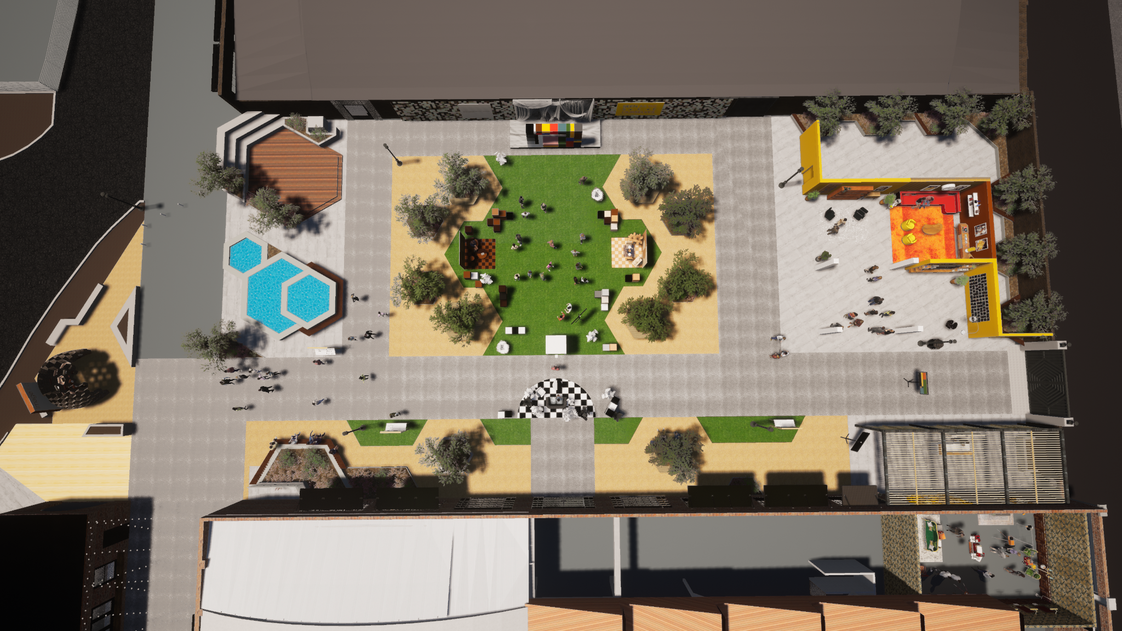
FINAL
03/28/22
Event Overview
6
9
5
4
7
1
KEY:
1 - Valet Drop-off
2 - Check-in
3 - Seen in Power
4 - Seen in Color
5 - Seen in Focus
6 - Seen as You See Yourself
7 - Gifting
8 - Restrooms
9 - Valet Pick-up
2
8
3
Notes:
Same address for driving and walking. Sign for valet will be visible externally. There will be a Brand Ambassador outside so folks have awareness, but no visible branded event signage.
Enter through small door and see this check-in counter to the right. No guest badges. 3x Brand Ambassadors will welcome them and check them in. Vaccine and ID check happens here too. Will have mask signage (masks while indoor and roof-covered spaces) at this check-in desk as well. No coat check.
Written intro text (AKA Manifesto) to the whole experience needs to be set up by check-in, or at least before going into Frederick Douglass
Screen to the left of check-in is where we intend to show the confessional videos, which they would see/hear after Frederick Douglass room
Confessionals - After Frederick Douglass room. Will run on loop, featuring all of the panel speakers. With audio from the Outdoor TV 75” (not audible in Frederick Douglass, but audible at check-in).
How long will this run? Max 3 minutes
Should cycle between three elements:
Mahaneela line from her confessional about directing this experience
Self-intros (via Title Page, vs audible self intros)
Answers to what image equity is to them
What image or visual expanded their idea of what’s possible

Slide 9
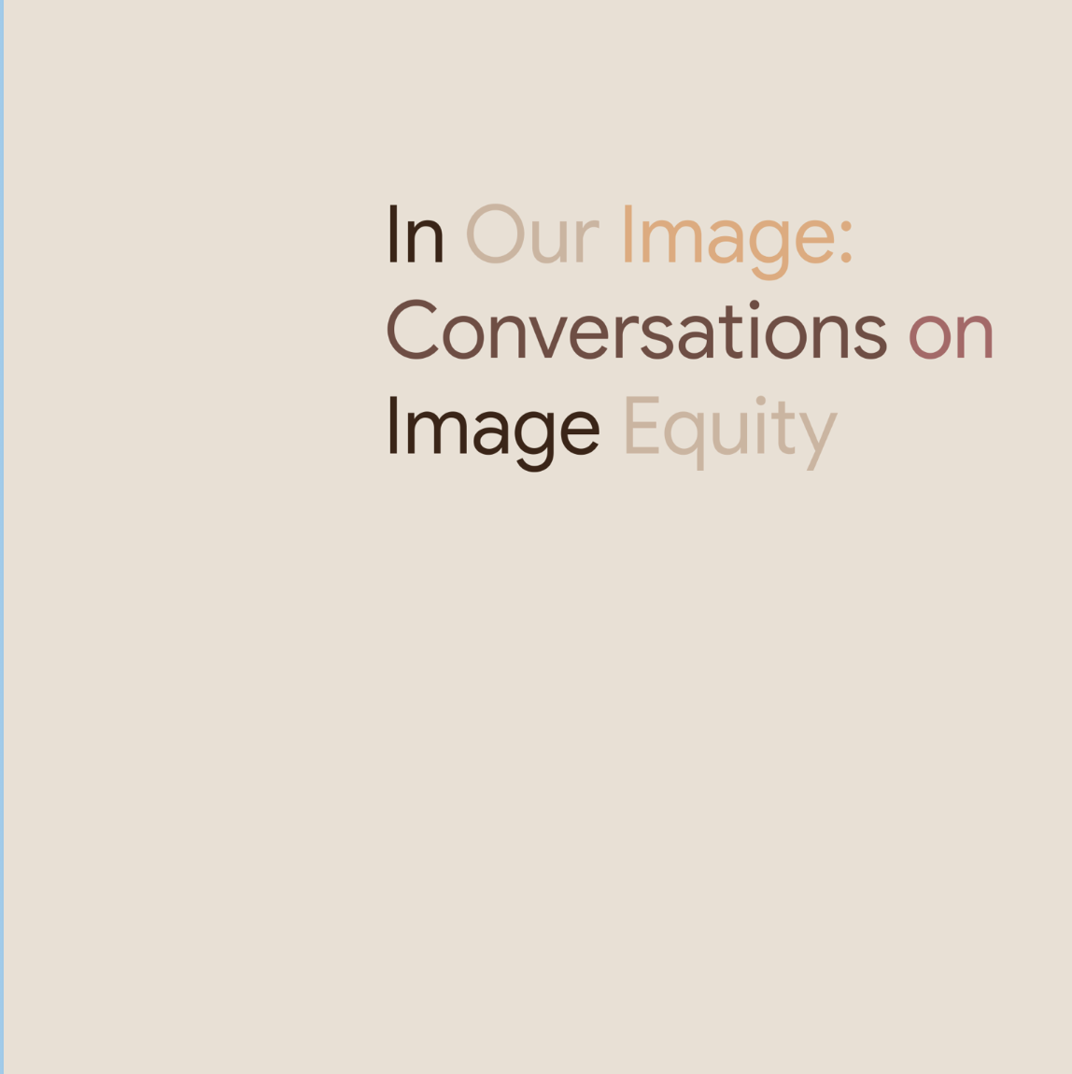
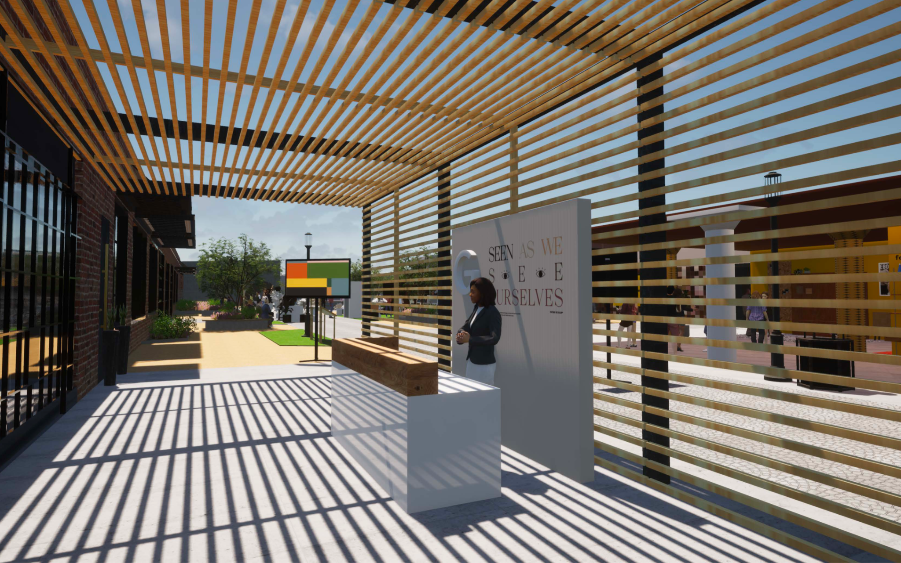
WIP
to be updated 03/29/22
Guest Experience
Insightful, concise content and experiences that speak to the impact of image equity on and for communities of color.
1
Entry Lounge
Welcome guests into space with event title, graphics, etc.
Notes:
Same address for driving and walking. Sign for valet will be visible externally. There will be a Brand Ambassador outside so folks have awareness, but no visible branded event signage.
Enter through small door and see this check-in counter to the right. No guest badges. 3x Brand Ambassadors will welcome them and check them in. Vaccine and ID check happens here too. Will have mask signage (masks while indoor and roof-covered spaces) at this check-in desk as well. No coat check.
Written intro text (AKA Manifesto) to the whole experience needs to be set up by check-in, or at least before going into Frederick Douglass
Screen to the left of check-in is where we intend to show the confessional videos, which they would see/hear after Frederick Douglass room
Confessionals - After Frederick Douglass room. Will run on loop, featuring all of the panel speakers. With audio from the Outdoor TV 75” (not audible in Frederick Douglass, but audible at check-in).
How long will this run? Max 3 minutes
Should cycle between three elements:
Mahaneela line from her confessional about directing this experience
Self-intros (via Title Page, vs audible self intros)
Answers to what image equity is to them
What image or visual expanded their idea of what’s possible

Slide 10
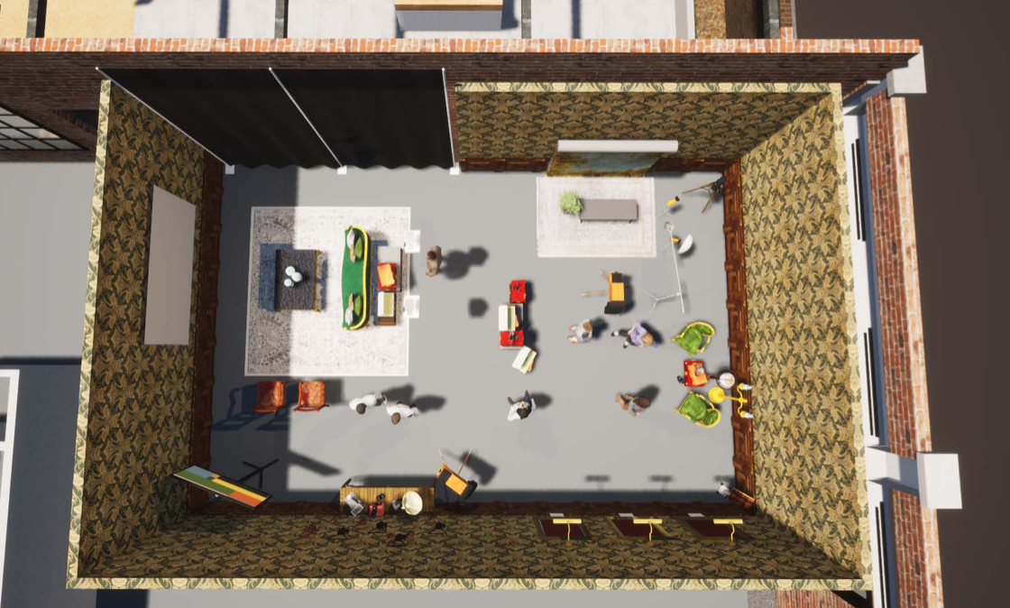
FINAL
03/28/22
2
Frederick Douglass + History Of Protest
Notes:
Walking past a drape (top left) into a covered, fairly dark room
Image slideshow (top left) will photo run from 1900s to the 1960s
Images to display for 10 seconds each, fade-in / fade-out
Need to make sure these are historically accurate and represent a mix of ethnic groups. Also need to ensure we’re offering the right context around those images.
Exploring how to give context to each image (e.g. plaque on the side, overlay text)
Images to be shown in space
Donna: Lower these to ~25, they’ll be sourced from Getty so we have decent information about the image
Need intro descriptive text to give context to the whole slideshow
AUDIO: Manifesto written on screen (bottom left), which will also play on audio, as well as excerpts from Frederick Douglass’ Lecture on Pictures (interplaying)
Just going to have Frederick Douglass lecture playing on audio and accompanying text on the screen.
VISUAL: Backdrop (top right) for folks to take pictures, captured by Smilebooth / Google Pixel 6 (housed within old camera). Printed portraits hanging on the walls (bottom right) of Ida B. Wells, Frederick Douglass & Sojourner Truth.
Option for non-Black subject in printed portraits?
Night Sight portrait mode, asking subjects to sit still (like they would back in the day), using soft diffused constant light with the Pixel 6

Slide 11
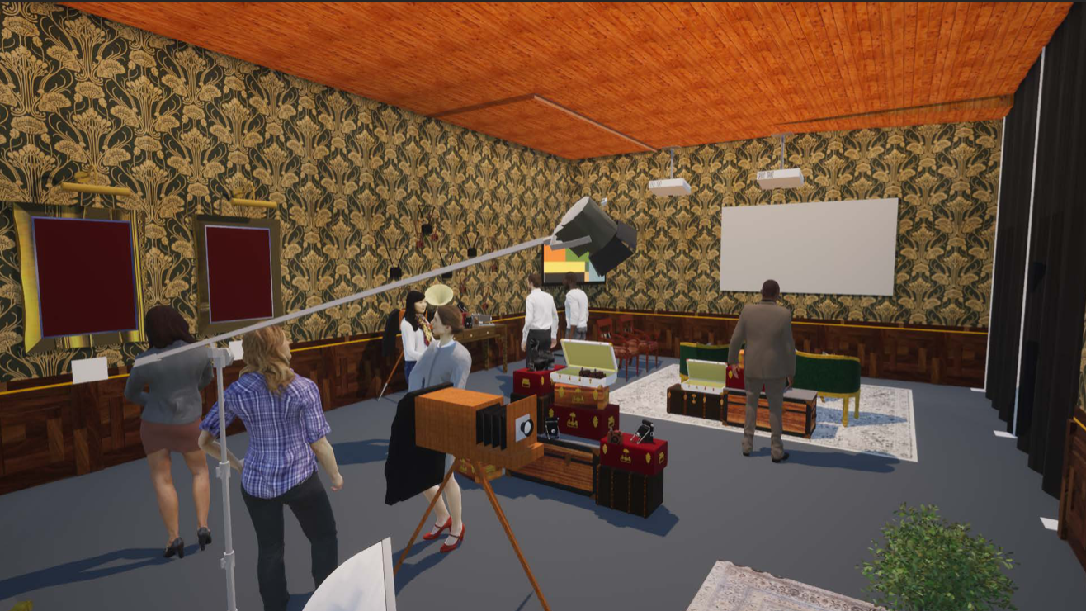
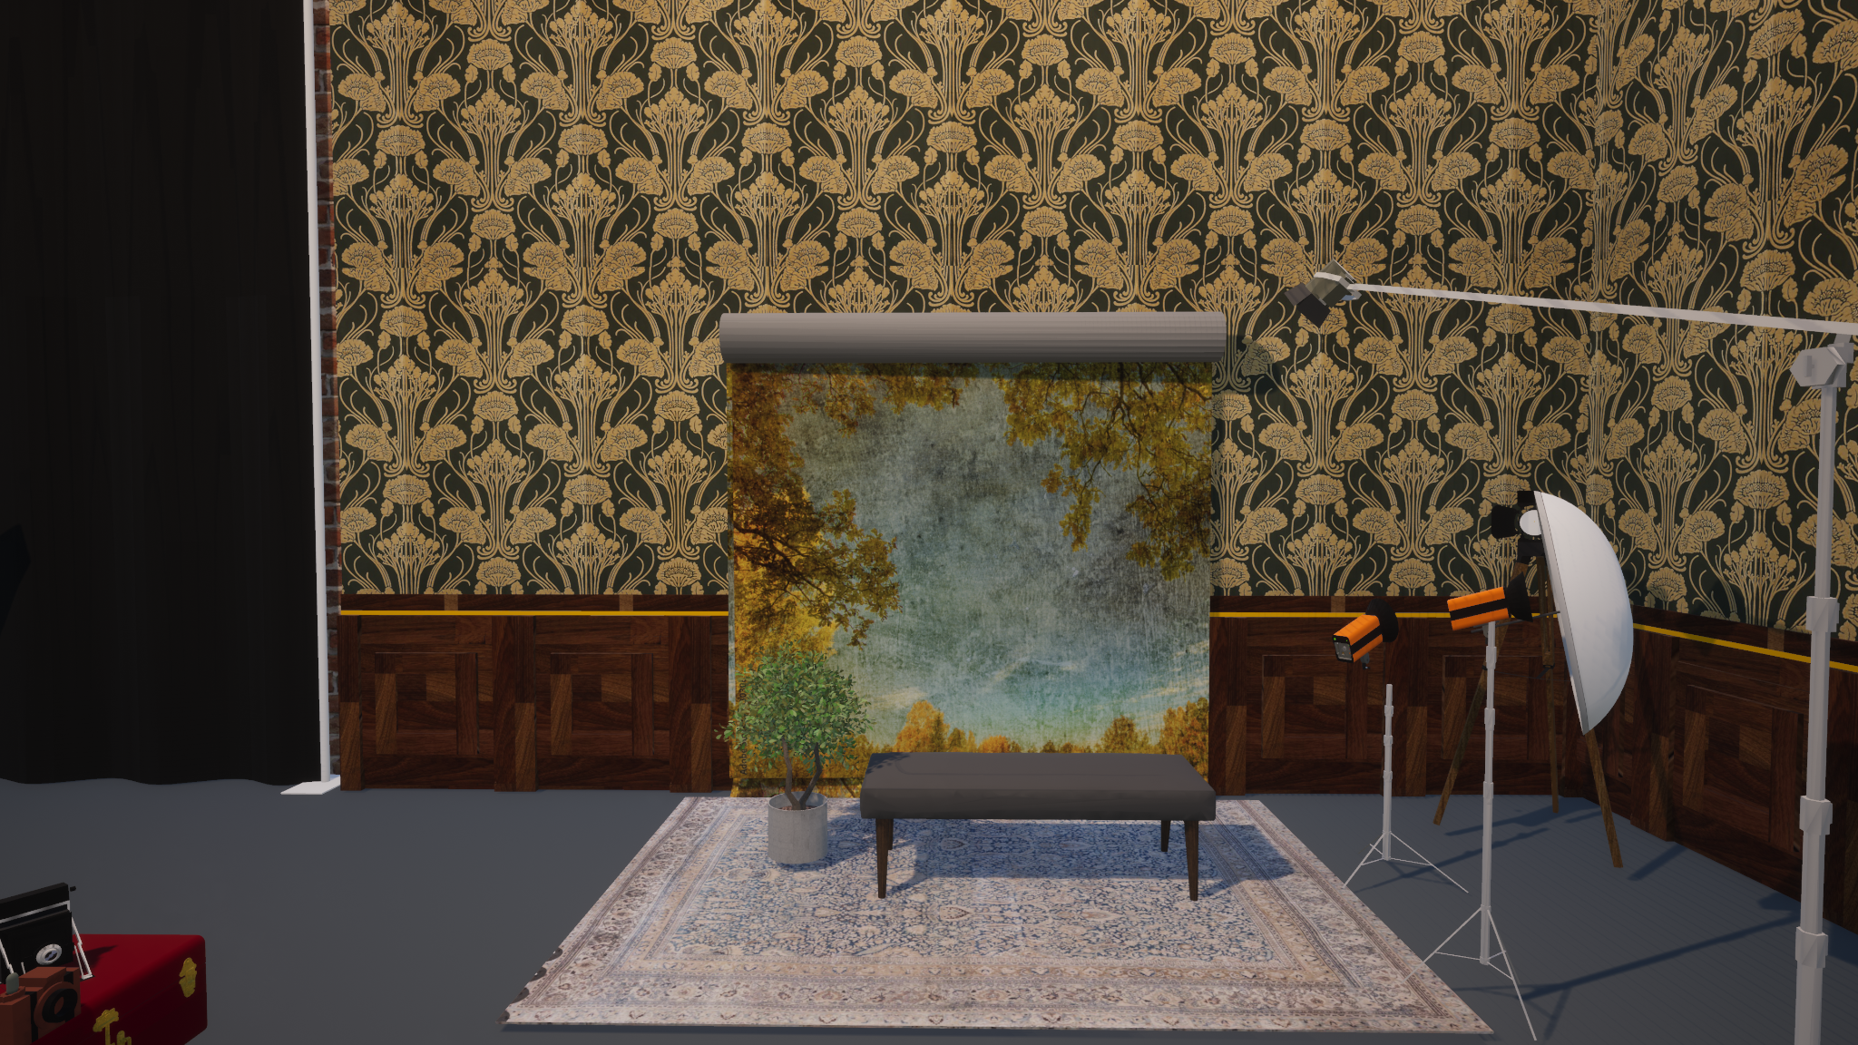
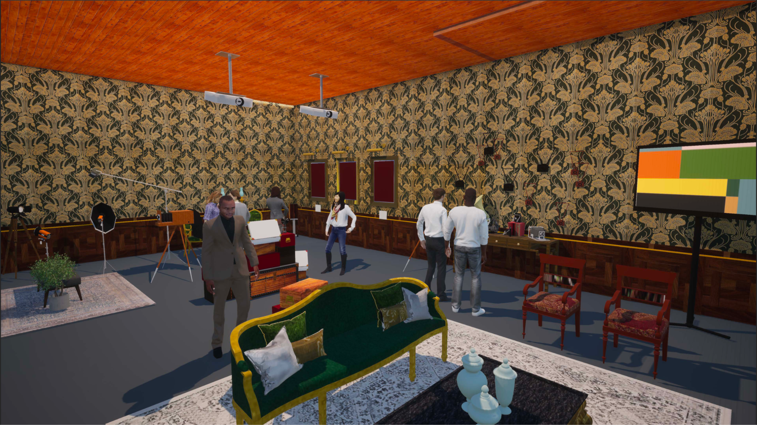
FINAL
03/28/22
2
Frederick Douglass + History Of Protest
Saloon style room detailing image-making as activism [e.g. Frederick Douglass, Ida B Wells] with accompanying video content.
Displaying images of international protests from early 1900s to 1960s.
Featuring a 19th century portrait photo moment.
*false walls will be built in this room for the wood paneling and wallpaper

Slide 12
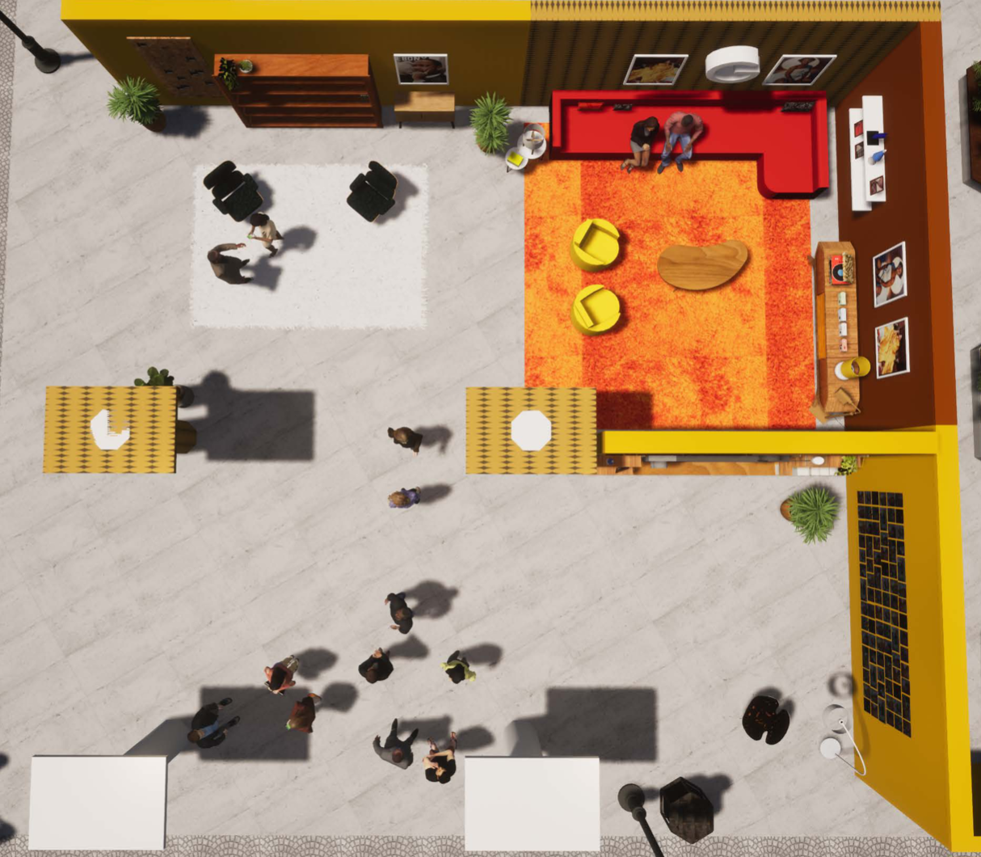
FINAL
03/28/22
3
Representation Boom in 70s
*this room will exist outdoors with only two walls and a ceiling.
Notes:
Walk around check-in to this space, entering from the bottom of the square
Whole space will be covered (not pictured), but open-air
Industry Panel Conversation on TV right outside
How big 75”? Audio from TV
AUDIO: Exploring sounds of the 70s (popular music from the time), playing low in the background almost as medley
VISUAL: Smilebooth Pixel 6 set up in bottom right, with subject sitting on the red couch (top right), through the faux TV
Need to make sure camera can focus on the subjects vs the TV frame, since they’re far apart
Subjects will have additional lighting that lives on the back of the TV, going for orange-tint sepia tone
On right bottom right (tiled wall) will be a ton of period-appropriate magazine covers featuring a number of folks of color across cultures - ~15 total
Top left will have coffee table of old school family photos sourced by Getty - 30 total
Need representative mix of cultures
Top right printed images will be of 70s icons (same note, need representative mix) - 4 total
Shoot your own album cover using props in the room, photographed by the guests themselves; then BA will roll around with Polaroid camera adding snaps to the wall

Slide 13
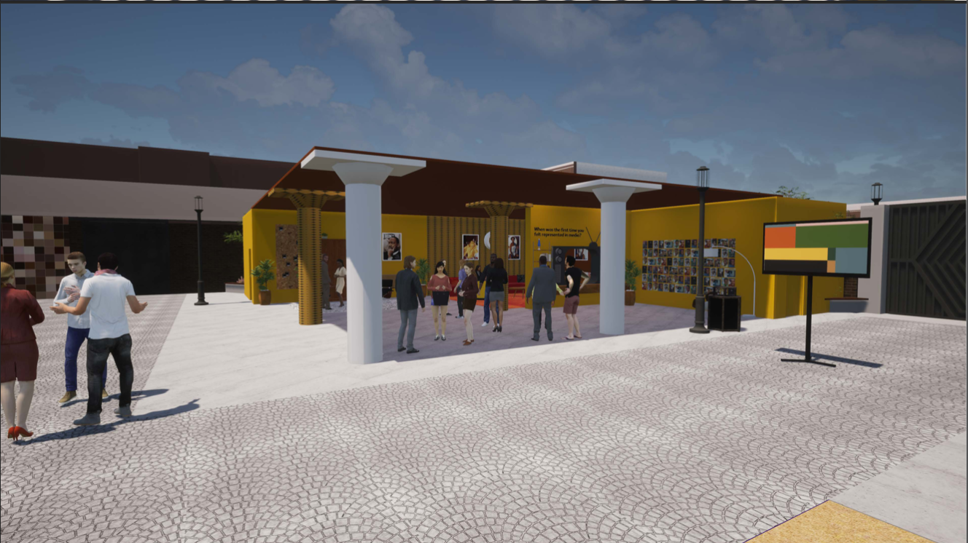
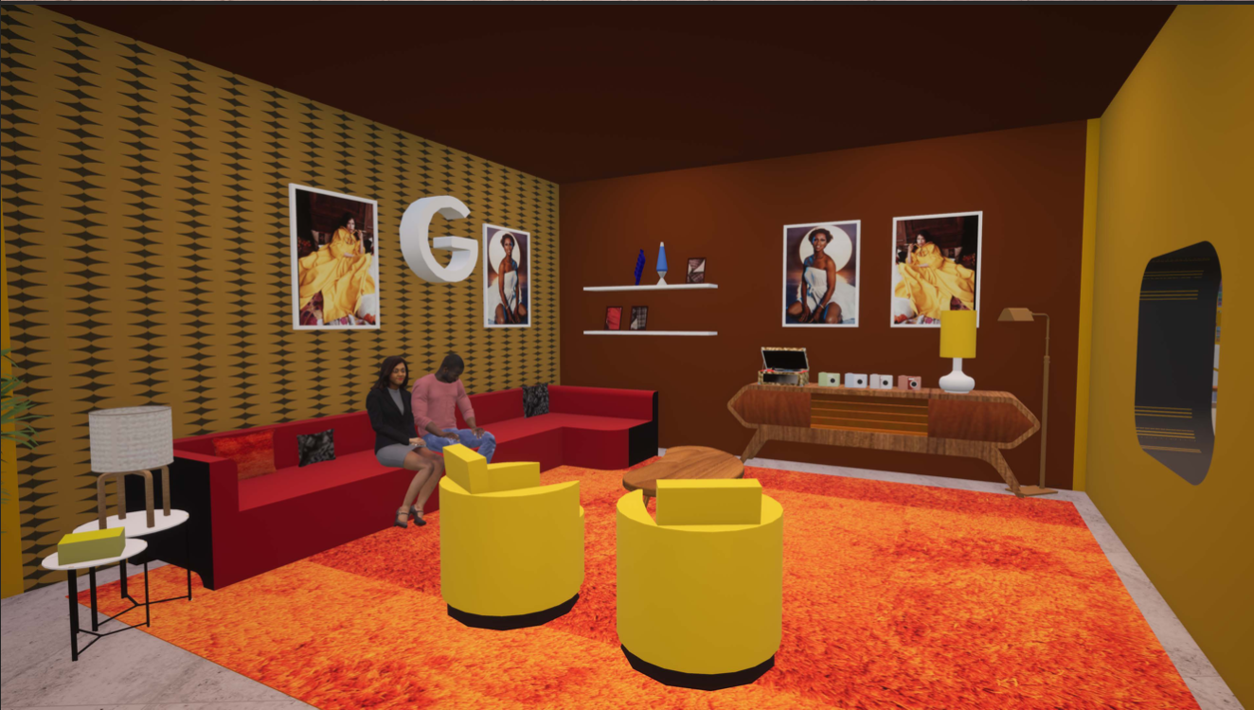
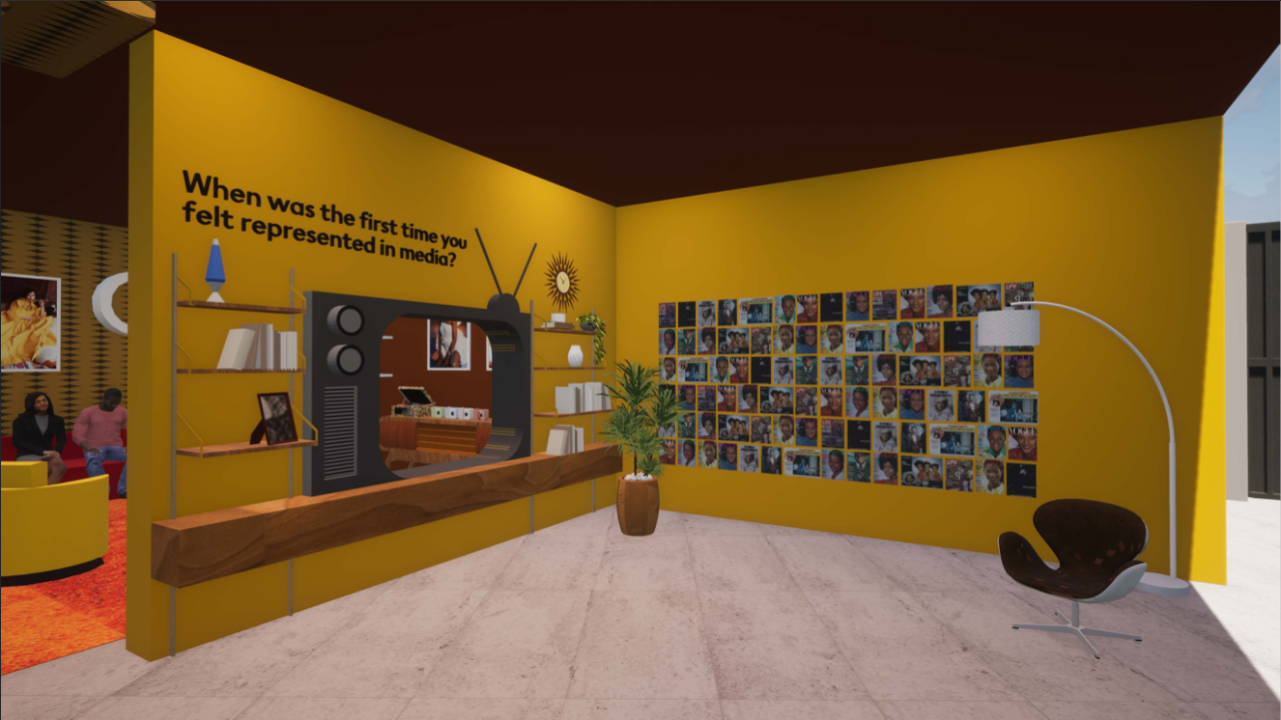
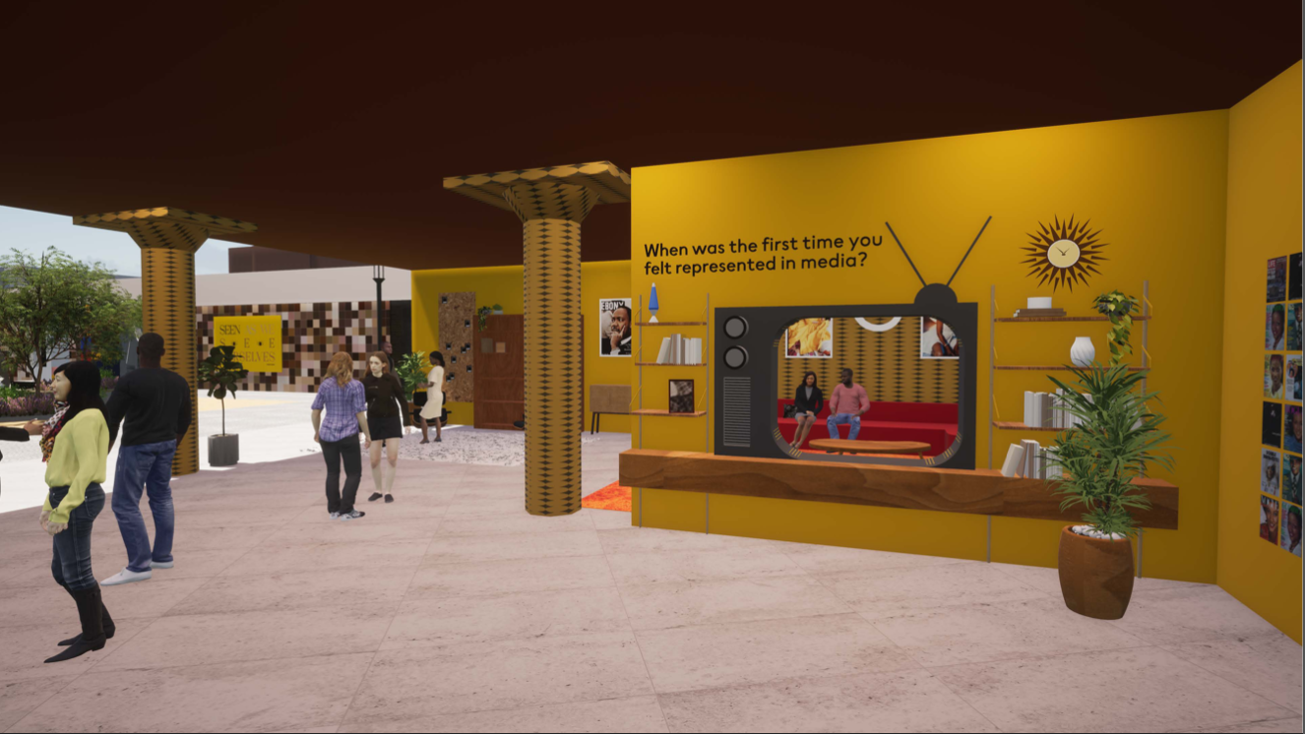
3
FINAL
03/28/22
Representation Boom in the 70’s
70’s living room film set photo moment featuring magazine cover wall of icons of color.
Photo albums will be displayed in a study next to the tv set, as well as a full collection of books, vinyls, comics, and an encyclopedia collection.
70s album cover photo moment using provided props.

Slide 14
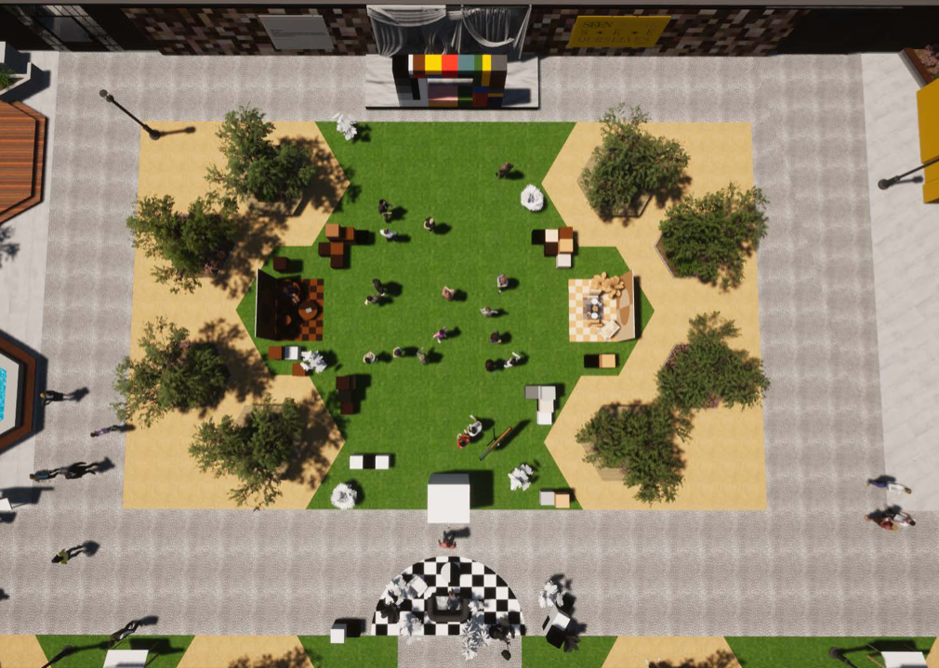
FINAL
03/28/22
4
The New Standard
Notes:
Call to Action
Brand Ambassadors will guide folks to space, present throughout to take photos of guests in front of 3x checker sets ups (B&W, Tan, Dark Brown) with Pixel 6 (no SmileBooth)
Screen showing Future Making Panel Conversation is bottom middle right, 75” TV, audio from the TV - team ensuring that audio here will be sufficiently strong for crowded outdoor space
MODU photo booth is the white box; will explicitly be branded as MODU (vs Google)
BAs will have Pixel C tablets that, when aimed at the color brick wall (top),
B8 to get new render for Modu experience (coming 3/31)
Sydney provided Monk Scale values for backdrop
Gifting table is bottom left (just out of frame), near valet

Slide 15
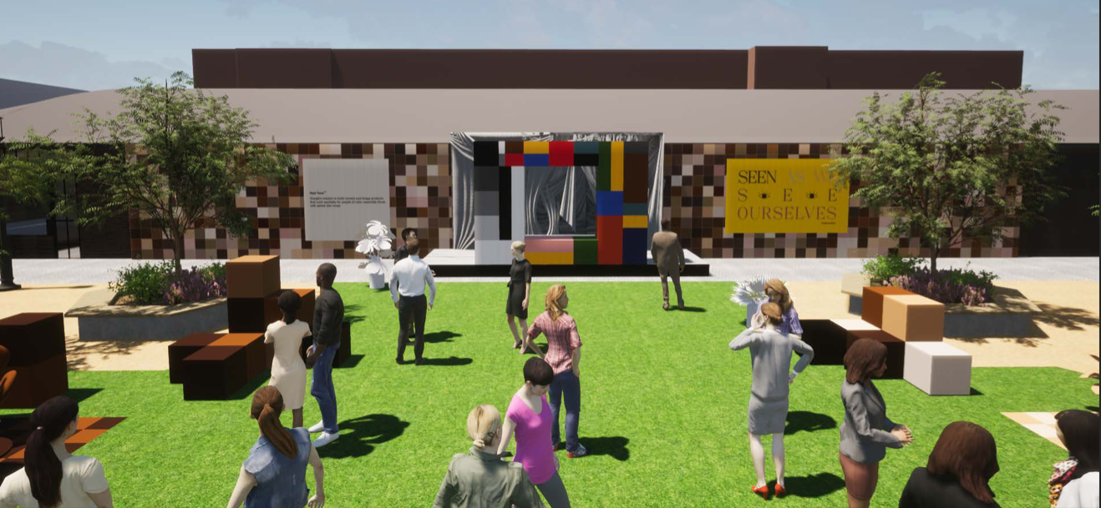
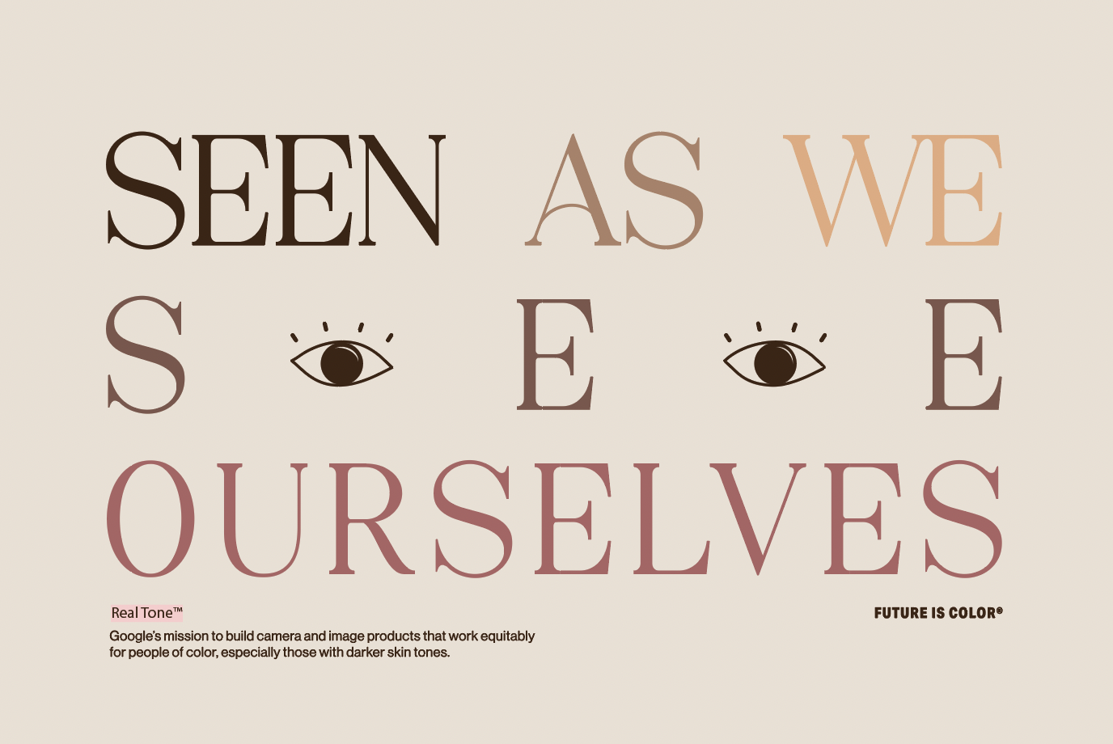
FINAL
03/28/22
4
“The New Standard”
Shirley Card-esque frame photo moment adds new twist to original, with the technology experience references color checkers, a tool that has been integral to color tuning in cameras.
Notes:
Call to Action
Backdrop behind new Shirley Card photo will be flat grey (similar to 90s Shirley Card)

Slide 16
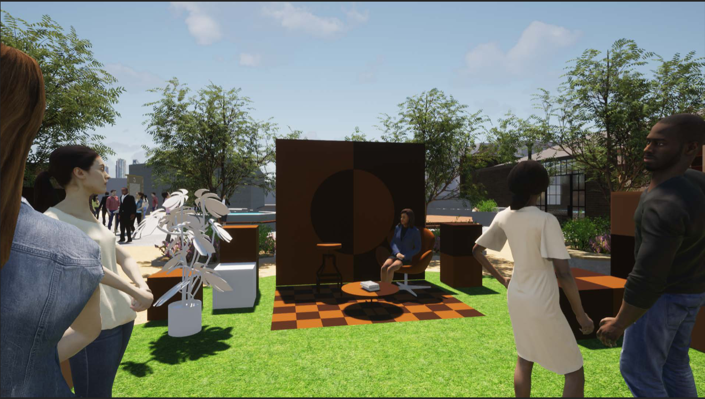
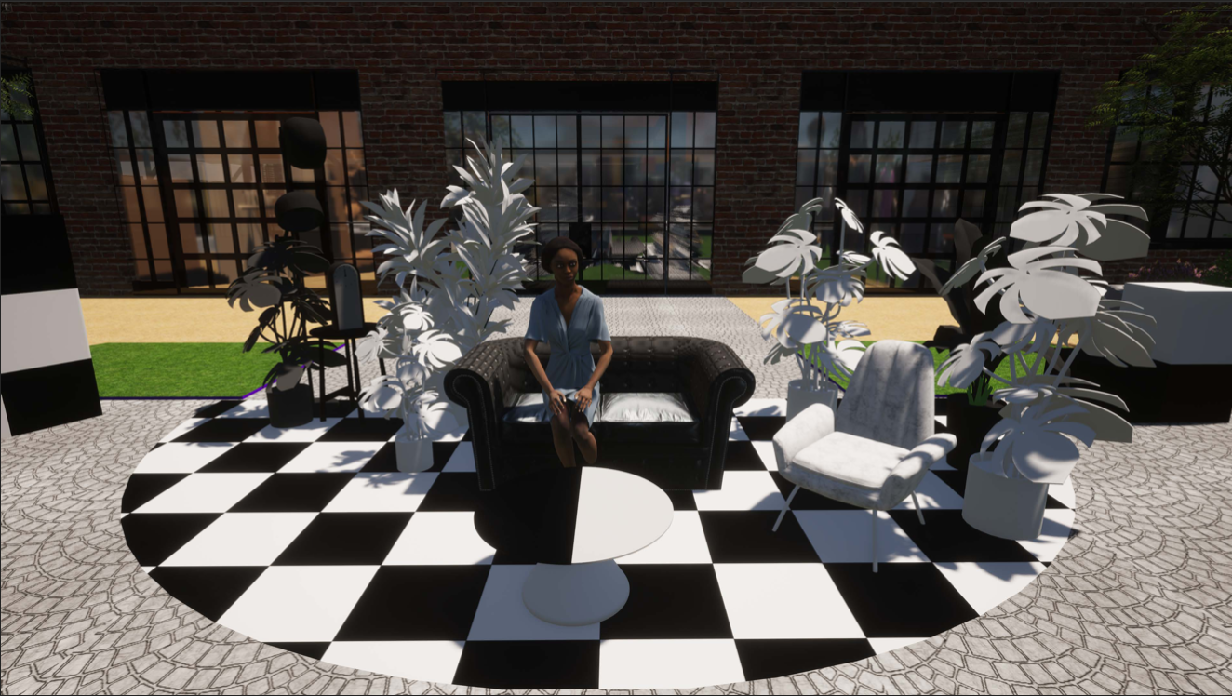
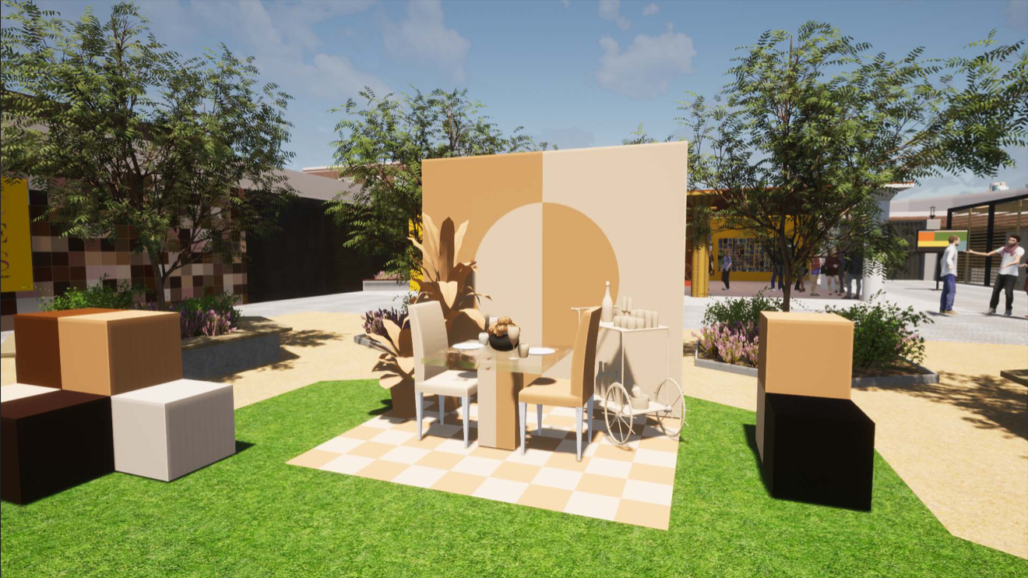
FINAL
03/28/22
4
Real Tone Zone
This portion of the experience explores skin tone hues and also the absence of color via vignettes/scenes of browns, tans, black and white.
Notes:
Call to Action

Slide 17
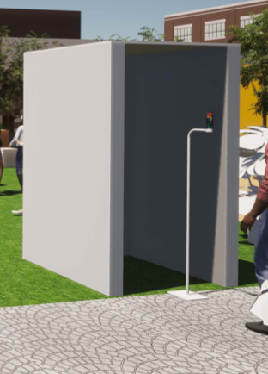
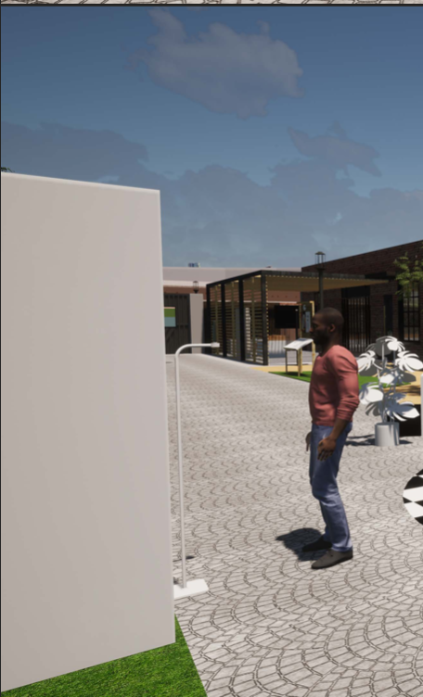
FINAL
03/28/22
4
The Infinite Palette
This experience is a custom made app by MODU Research, a first-generation canadian duo of app developers.
With this app, we reimagine the colorchecker as a technology that pulls hues from your skin, rather than from an index of colors already in its system.
See more details here.
Notes:
Call to Action

Slide 18
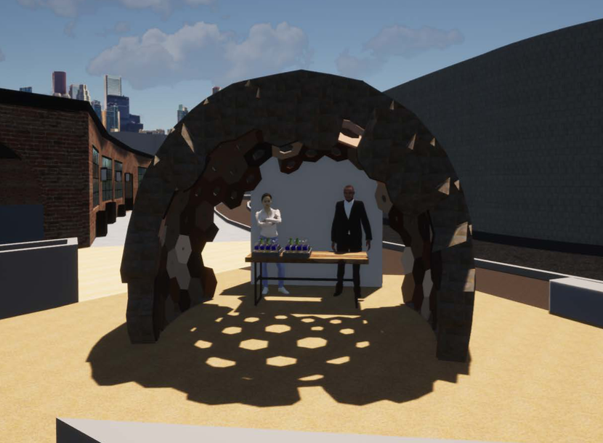
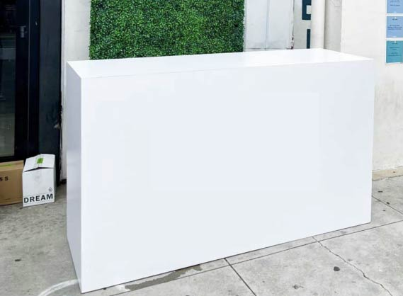
FINAL
03/28/22
5
Gifting Moment
Elevated space and gift bar that will be staffed by guest relations to add a personal touch.
Notes:
Will have retractable stanchions to manage line, as well as BAs helping
Guests will collect their bags, as directed by BAs, while they’re in the outdoor space
B8 team managing check-in list, matching against who has checked in and bags will be organized alphabetically. Phones will have their serial numbers recorded for each gift bag as well for tracking.
FPO - for activation 2 (not a phone demo, more of a gifting station)
Having self functioning booths in each room or one room so people can take a pic and send to themselves.
**B8 to start the workback based on what we have now. Who and when will we begin going
Phone Demo >> Phone bar? gifting bar

Slide 19
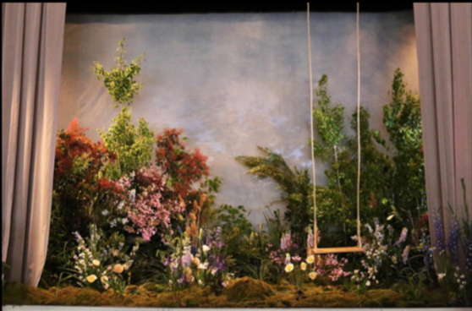
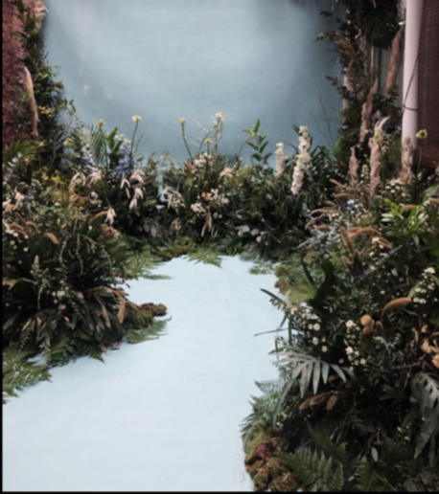
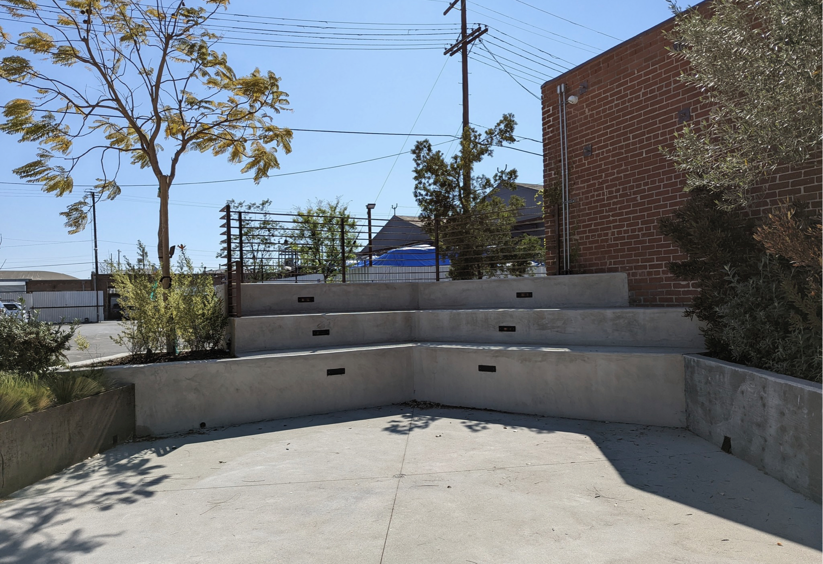
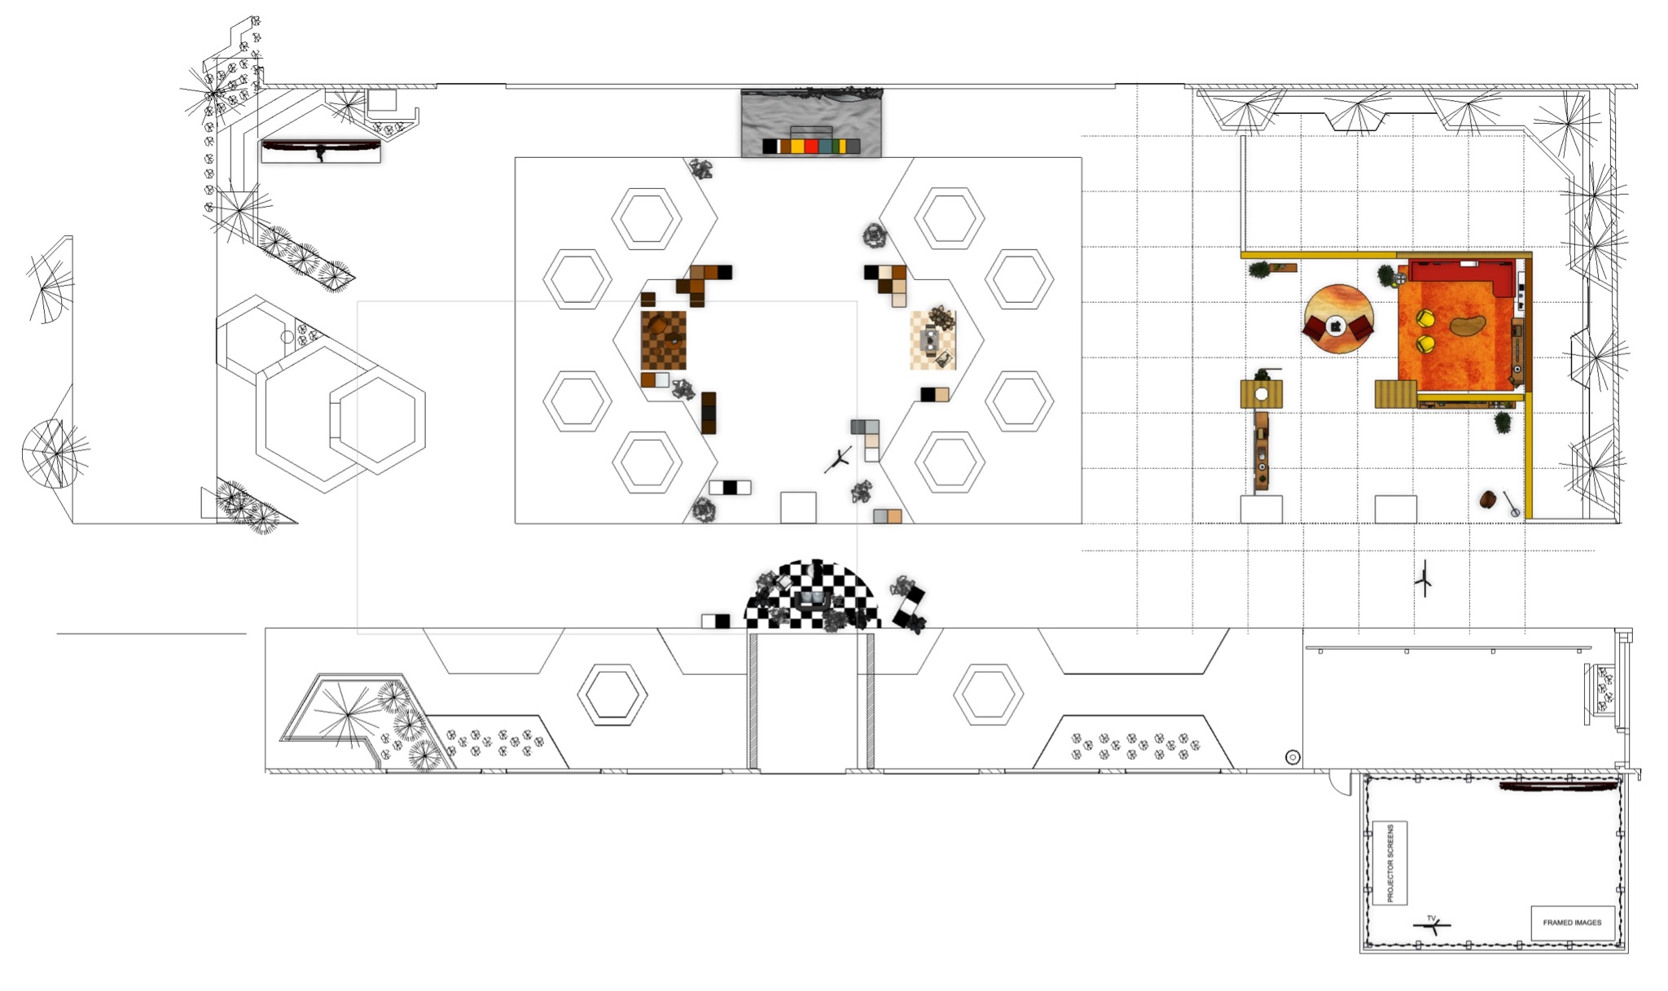
WIP
to be updated 03/30/22
Pixel 6 Real Tone Portrait Moment
Notes:
Call to Action

Slide 20
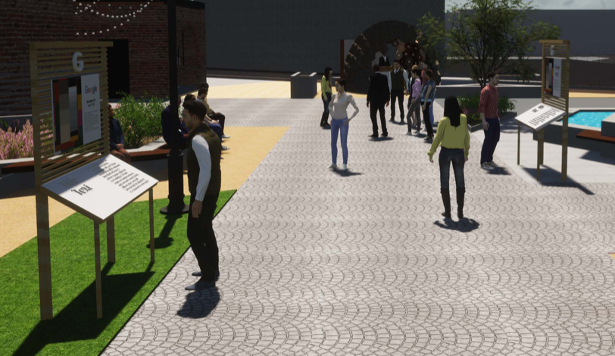
FINAL
03/28/22
Google Kiosks
Notes:
Call to Action

Slide 21
Venues + Logistics
Beyond8 | Creative Theory Agency, 2022

Slide 22
Los Angeles, CA
Thursday, April 7th, 2022 | 3:00 - 6:00pm PT (VIPs)
Friday, April 8th, 2022 | 11:00am - 3:00pm PT (Orgs + Students)
Beyond8 | Creative Theory Agency, 2022
Notes:
Cap vip guest list at 60

Slide 23
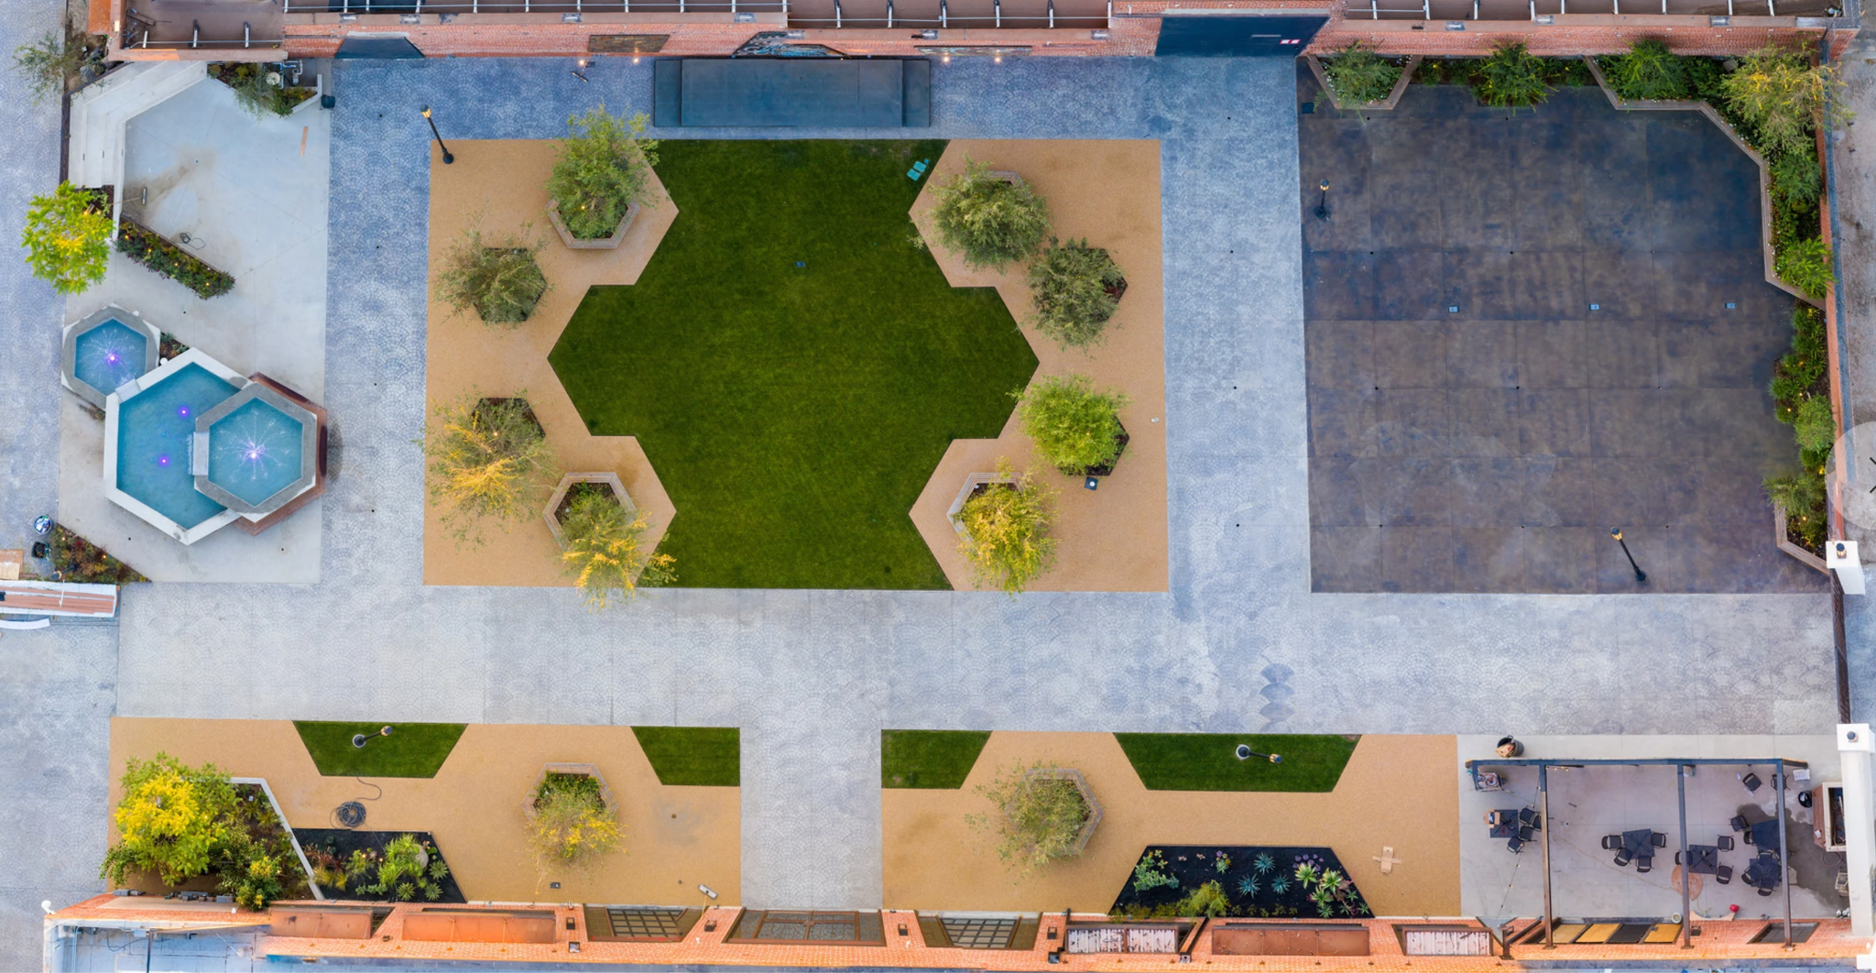
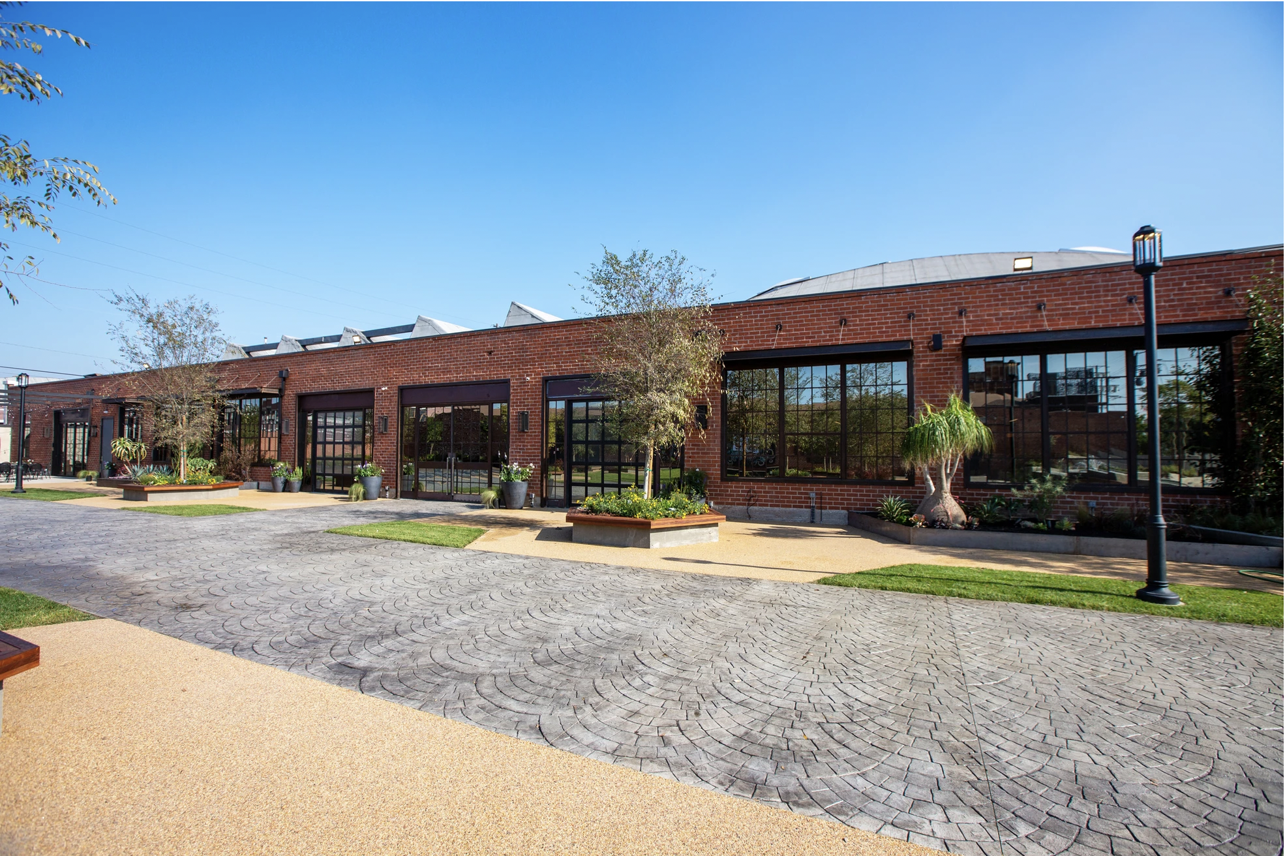
FINAL
03/28/22
Venue
hybrid indoor/outdoor space
DTLA
SoLa Beehive
~120 Student/Org Partner guests (Morning)
~ 100 VIP guests (Afternoon)

Slide 24
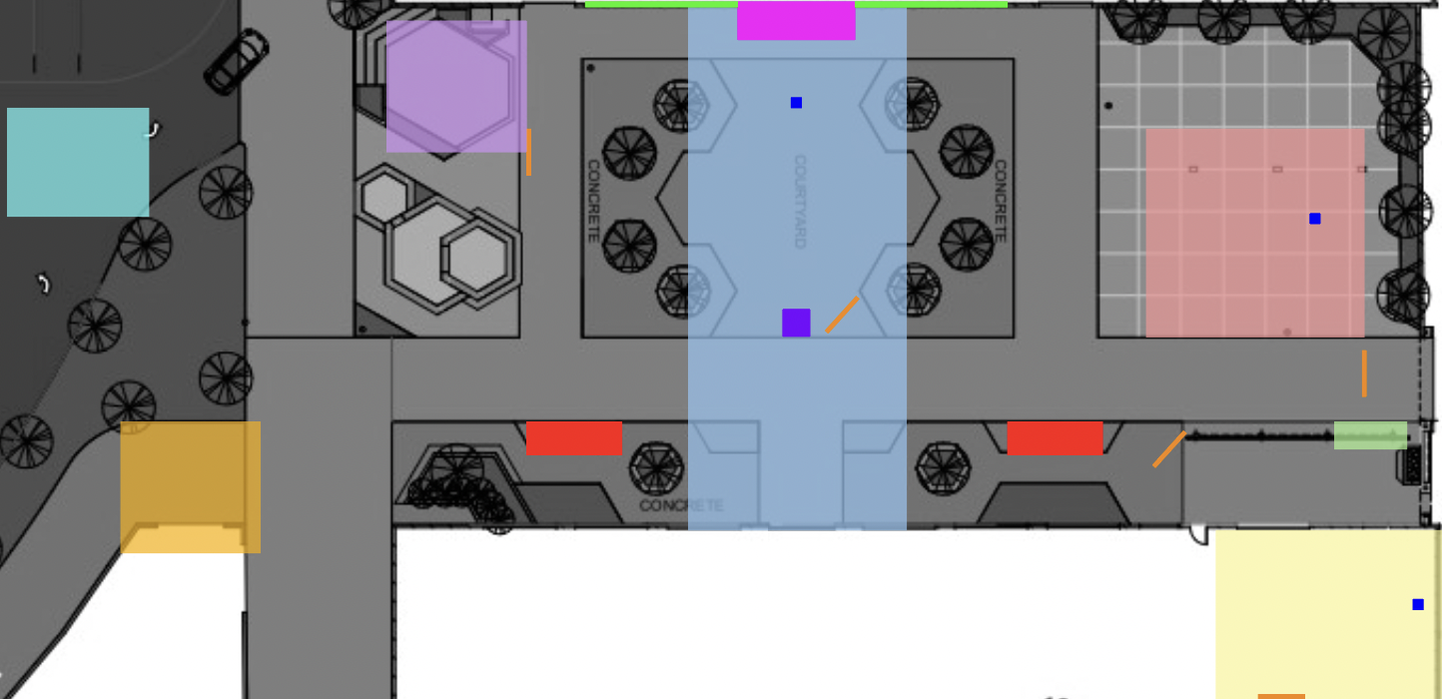
FINAL
03/28/22
Guest Journey Overview
REGISTRATION
ACTIVATION PART 1, “FREDERICK DOUGLASS + HISTORY”
SPEAKER CONTENT
- SHOWCASED ON 75” INDOOR/OUTDOOR SCREENS
GOOGLE KIOSKS
ACTIVATION PART 2, “REPRESENTATION BOOM IN THE 70’S”
ACTIVATION PART 3, “THE NEW STANDARD”
- TONAL VIGNETTE MOMENTS
- VINYL ON EXISTING WALL
SHIRLEY CARD FRAME PHOTO MOMENT
THE INFINITE PALETTE PHOTO MOMENT
PORTRAIT MOMENT
- BACKDROP/BUILD TO BE RECEIVED FROM PHOTOGRAPHER
GIFTING MOMENT
VALET PICKUP
SMILEBOOTH

Slide 25
Student + Org Guests
Thu Apr 7, Morning
content
Attendees will be invited from underrepresented student groups affiliated with UCLA, and local photo-focused organizations in the Los Angeles area.
Guided into the Frederick Douglass room where they encounter the first programming experience
Each subsequent “room” will have relevant content running to provide guest clearer context on the initiative(s).
activation
Three themed spaces that reference notable moments in the arc of photography’s history: (1) a 19th century saloon with references to Frederick Douglass’ use of photography as activism; (2) a 1970s space that looks at representation of communities of color in media at the time and (3) a “future” space that’s themed around establishing new technical standards for photography built with and for communities of color.
See above slide for WIP renders
Throughout the spaces, attendees will be able to watch the pre-recorded expert speaker talks, presented as exhibition installations.
In each room, attendees will have the opportunity to sit for staged portraits shot with the Google Pixel 6, featuring Real Tone.
There will be a few screen experiences throughout that highlight Google’s image equity product work on Google Pixel 6, Google Photos and Google Meet.
*Note: this event is not open to the general public.

Slide 26
VIP Guests
Thu Apr 7, Afternoon
content
Guided into the Frederick Douglass room where they encounter the first programming experience
Each subsequent “room” will have relevant content running to provide guest clearer context on the initiative(s).
Guests register upon entrance and are given activation map + overview collateral.
VIP event is private to invited guests,
activation
Three themed spaces that reference notable moments in the arc of photography’s history: (1) a 19th century saloon with references to Frederick Douglass’ use of photography as activism; (2) a 1970s space that looks at representation of communities of color in media at the time and (3) a “future” space themed around establishing new technical standards for photography built with and for communities of color.
See above slides for WIP renders
Throughout the spaces, attendees will be able to watch the pre-recorded expert speaker talks, presented as exhibition installations.
In each room, attendees will have the opportunity to sit for staged portraits shot with the Google Pixel 6, featuring Real Tone™.
There will be a few screen experiences throughout that highlight Google’s image equity product work on Google Pixel 6, Google Photos and Google Meet.
gifting
VIP attendees will receive with gift bags that include a Google Pixel 6, branded microfiber cloth, 3x Aperture publications, custom tote, and glass water bottle.

Slide 27
NYC
Thursday, April 28th, 2022 | 1:00 - 4:00pm ET
Beyond8 | Creative Theory Agency, 2022
Notes:
Cap 40 guests in NY

Slide 28
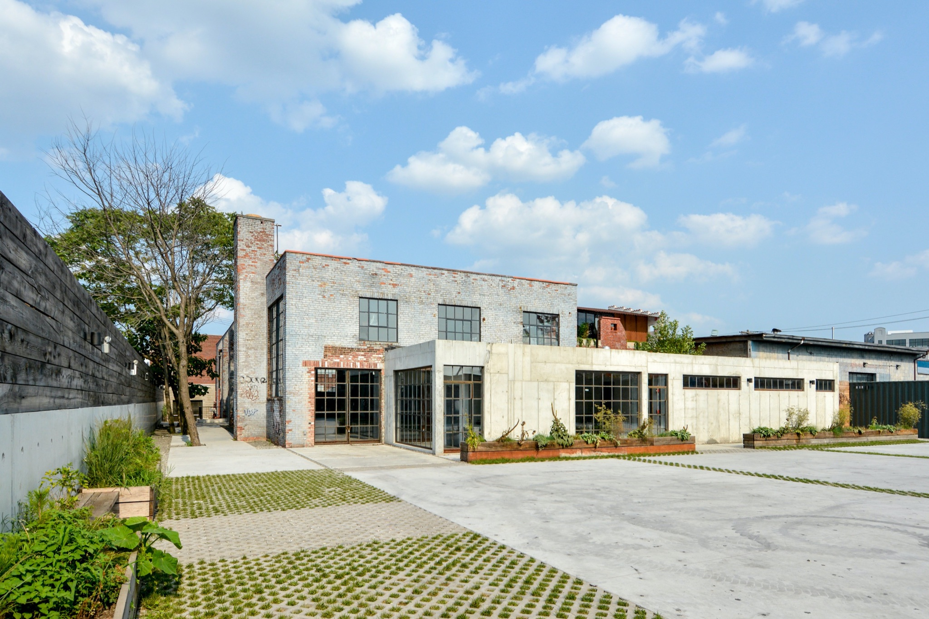
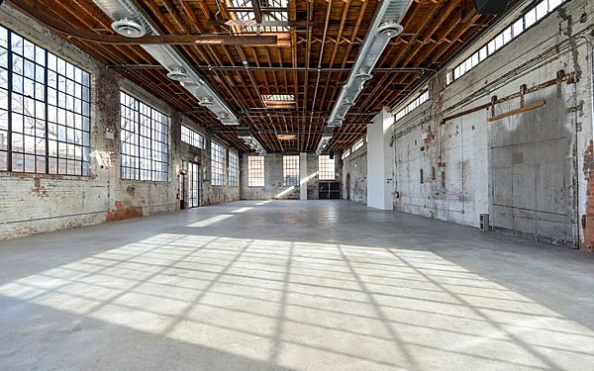
Venue
hybrid indoor/outdoor space
Williamsburg, BK
99 Scott
Weather considerations: Setup as covered space that is heated and water proofed.
~ 45 VIP guests

Slide 29
Guest Journey
vip
content
Guided to the programming start area with intro video.
Video content experience in programming theater
Invited guests register upon entrance and are given activation map + overview collateral.
VIP event is closed to the general public.
program
Group is lead to an open format space where Florian Koenigsberger will start off the open conversation with guests to uncover how this community can ensure image equity is achieved.
Eat a light lunch [salad/quinoa/Fruit/Cava style] or Light h’dourves passed
Phone Demo tables and Shirley Card photo booth moment from LA
Outside and inside will include expert commissioned photography, scaled down from LA
gifting
VIP attendees will end experience with gift bags that include Google Pixel 6 phones, branded lens wipes, tote, and glass water bottle.

Slide 30
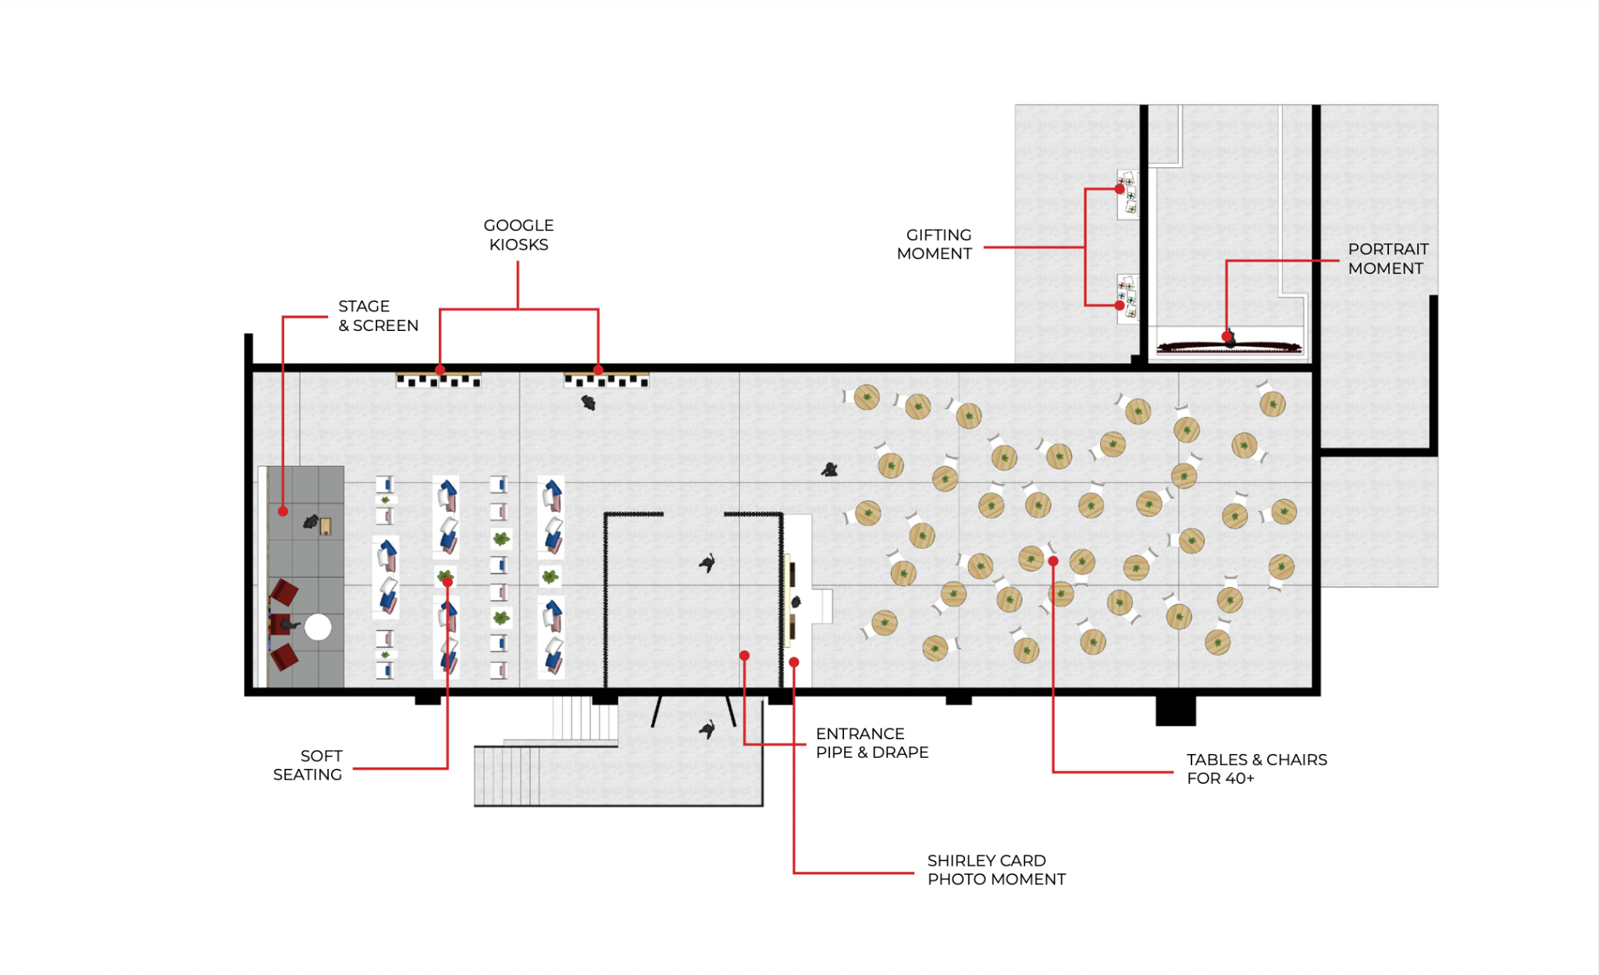
WIP

Slide 31
Content
Pre-Recorded Expert Speakers
Beyond8 | Creative Theory Agency, 2022

Slide 32
Expert Confessionals
The Content
Participating expert speakers were asked a series of questions in beautiful confessional-style interviews about their backgrounds, their work and purpose, and what image equity means to them.
IMAGES TBD
Note: As of Wed 3/23, our team is working through first rough cuts of these panel conversations.
End output will be 1x 1-2 min sizzle reel featuring all of the experts introducing themselves and their work.
The guiding questions for each discussion can be found here.

Slide 33
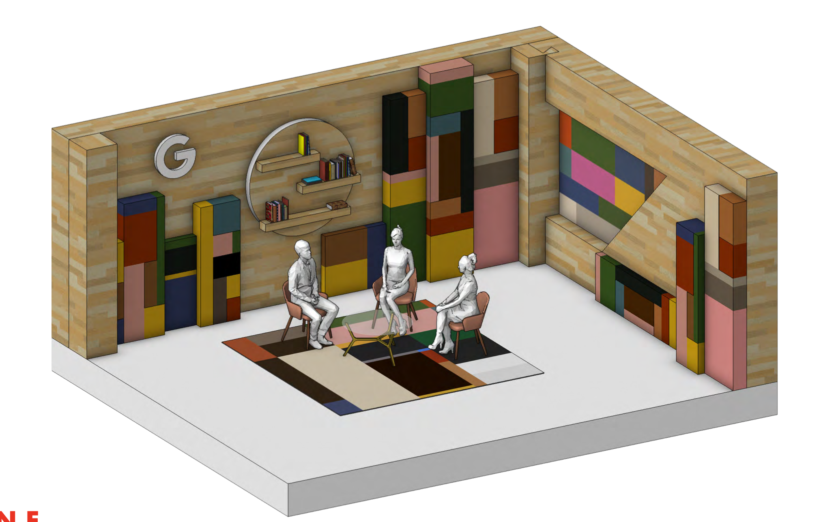
Expert Panel Conversations
The Stage
A custom fabricated stage will serve as the backdrop for each of the pre-recorded panel conversations, making it feel as though they are part of a larger, connected single conversation on Image Equity.

Slide 34
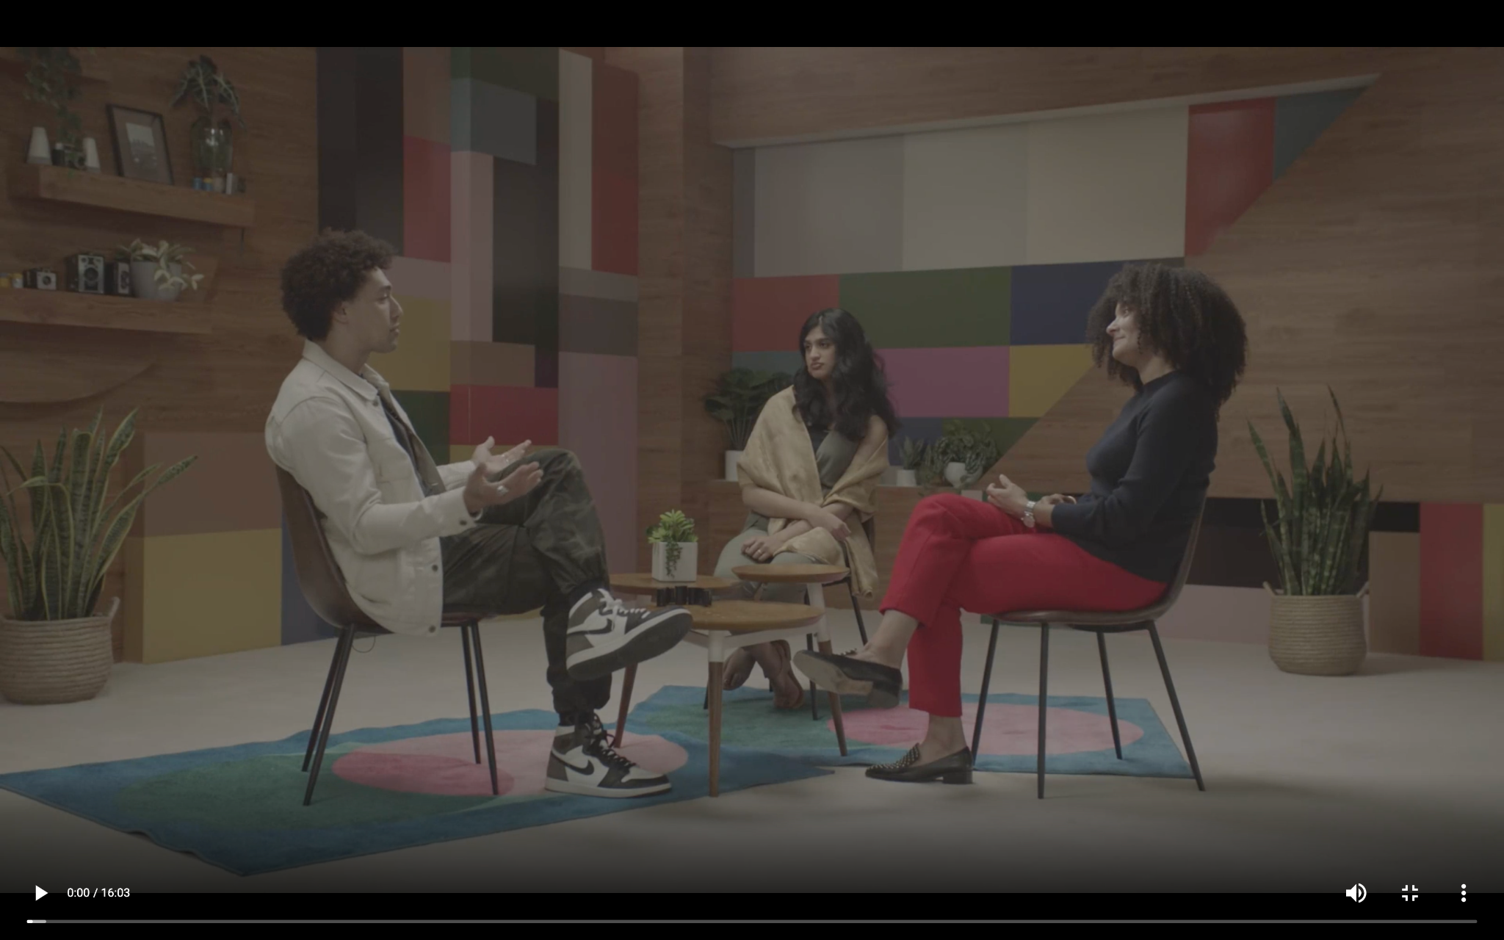
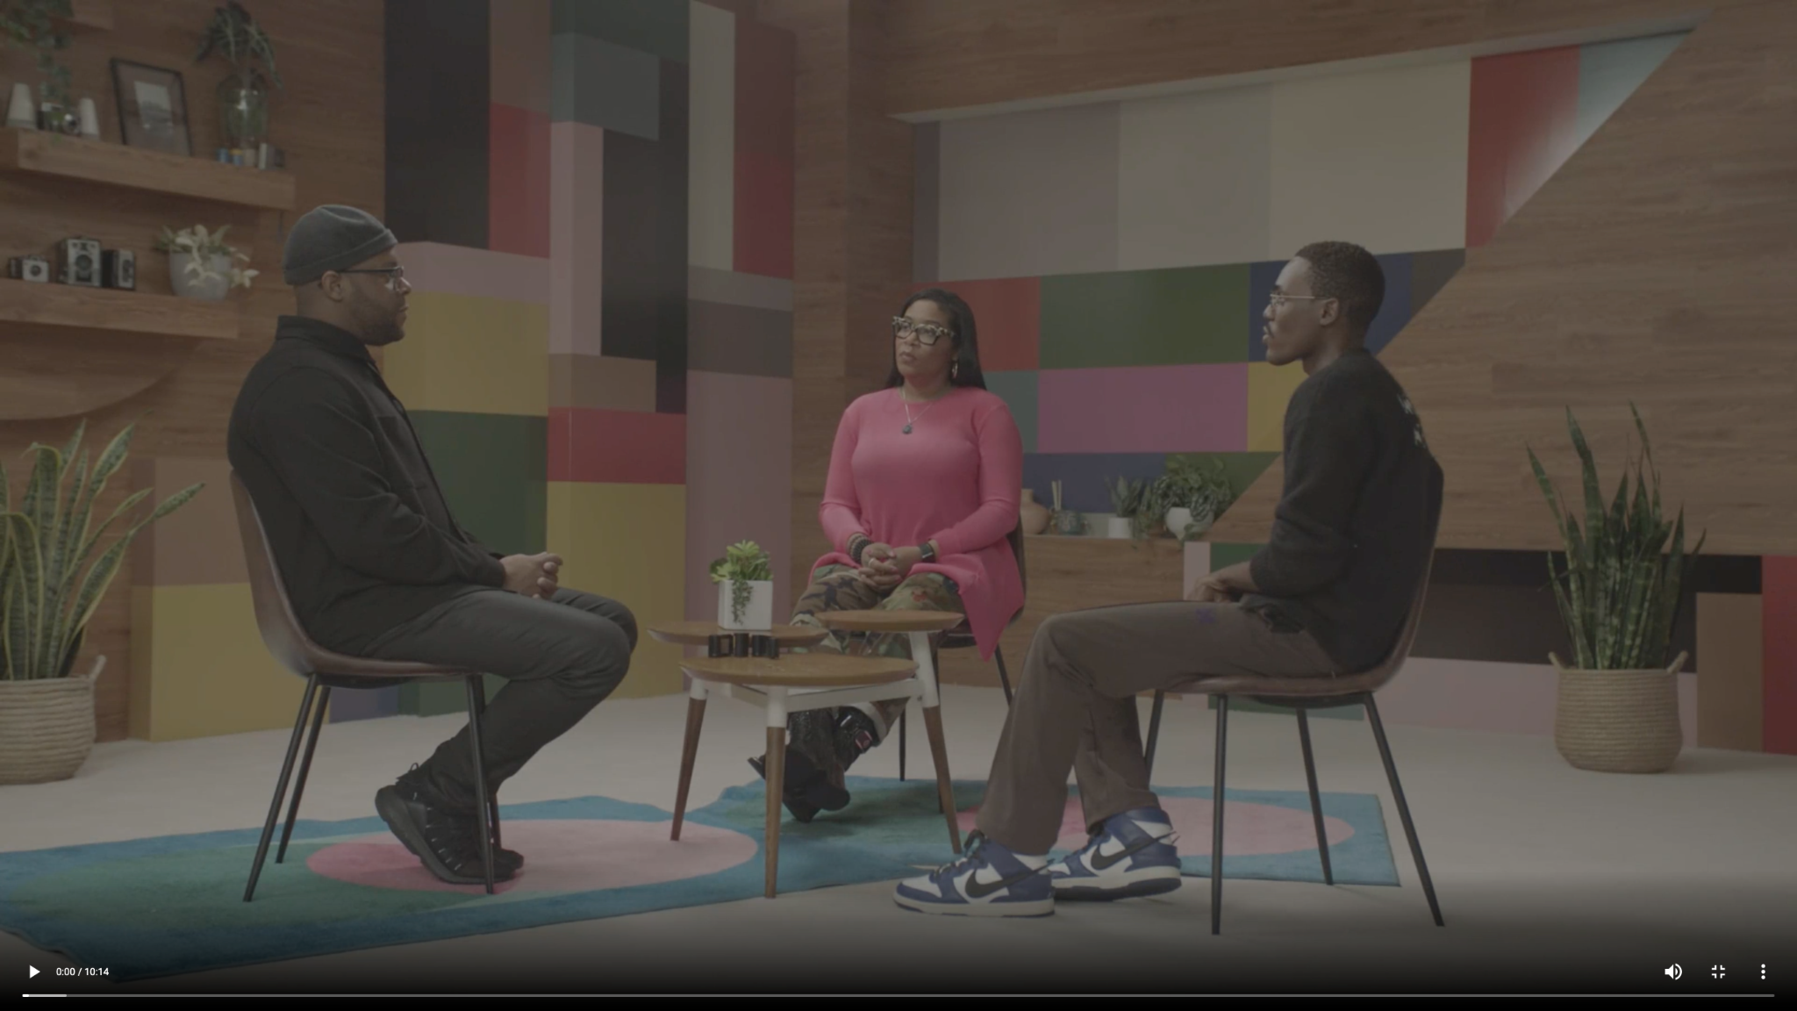
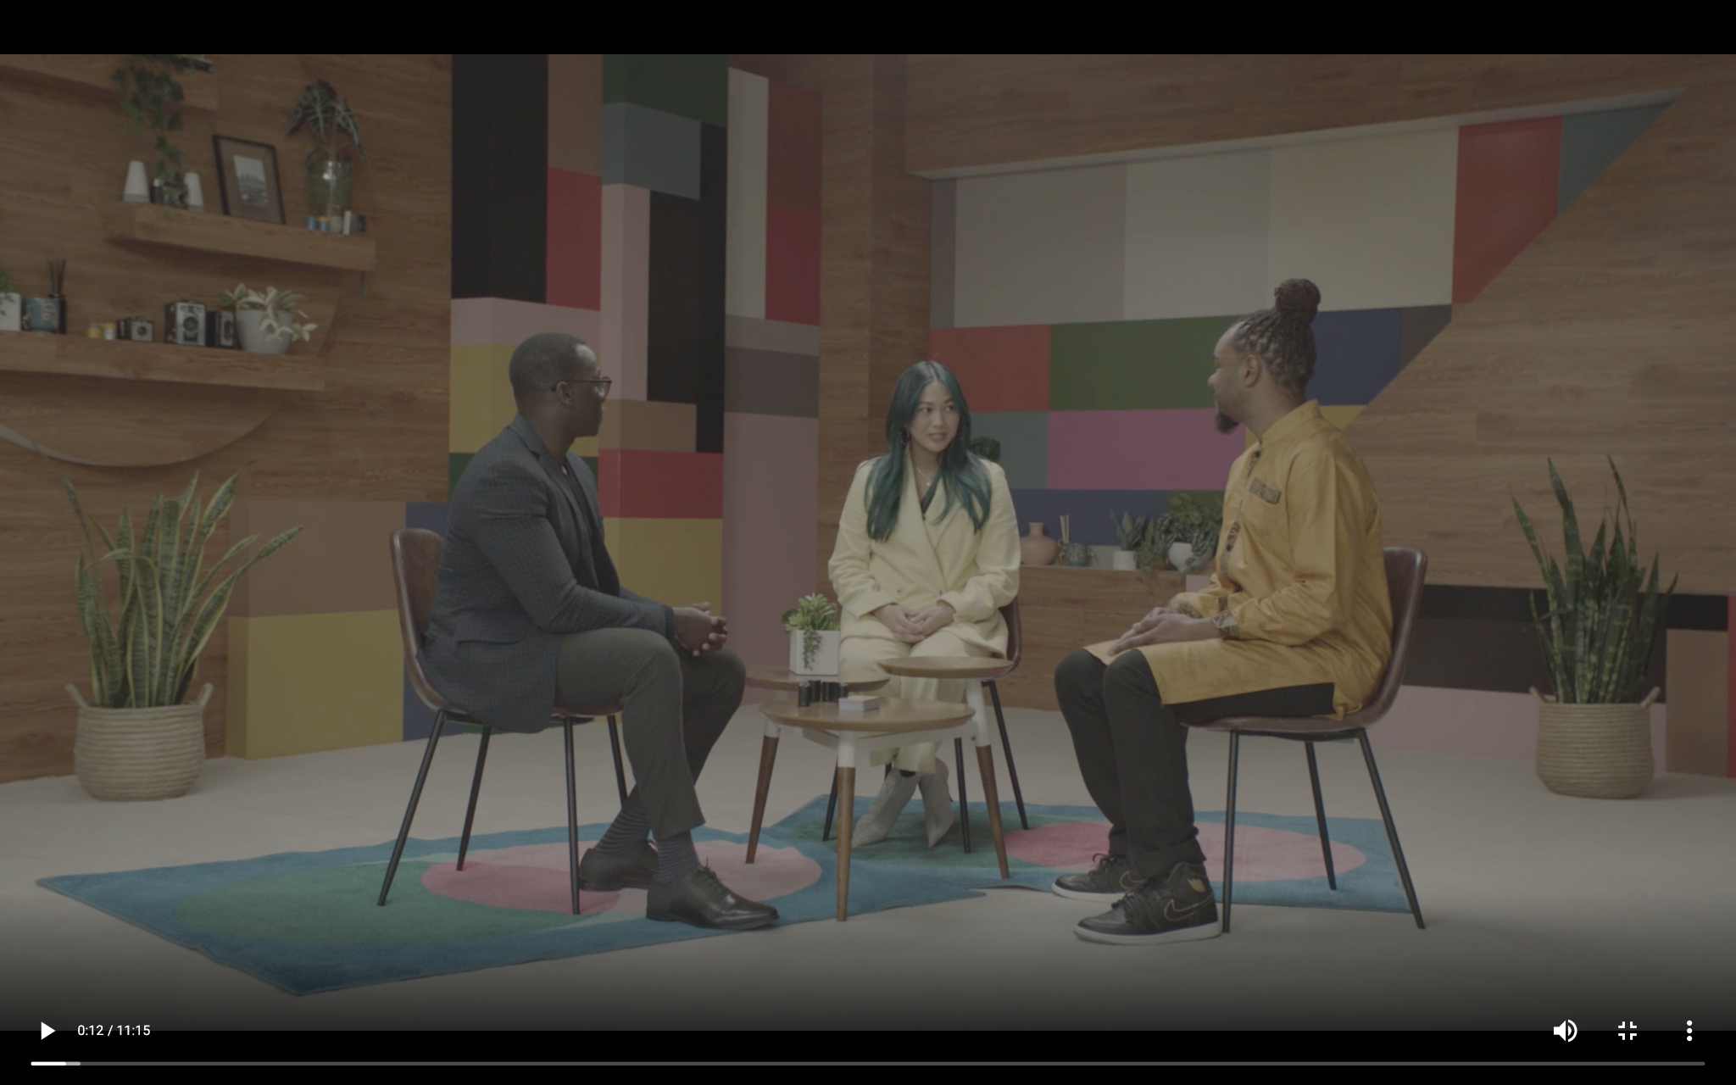
Expert Panel Conversations
The Content
1
Google’s Image Equity Initiative
A conversation on Google’s work to fight bias in photography by creating more equitable camera and imagery products, featuring Florian Koenigsberger (Google Image Equity Lead), Tulsee Doshi (Google Responsible AI & ML Fairness Lead) & Kira Kelly (A.S.C. Cinematographer).
2
Creativity & Community in the Industry
A dialogue between extraordinary photographer duo AB+DM Studio and celebrated costume designer Marci Rodgers exploring the importance of normalizing representation across in storytelling across creative industries.
3
Visions for the Future
Stories and insights from three pioneers charting a more equitable future in education, medicine and skin care, featuring author and sociologist Dr. Marcus Hunter, cosmetics expert and entrepreneur Joyce de Lemos and medical student and TikTok sensation Joel Bervell.
Note: As of Wed 3/23, our team is working through first rough cuts of these panel conversations.
End output will be 3x 5-8 min cut downs of each conversation, to be viewed throughout the event space.
The guiding questions for each discussion can be found here.

Slide 35
Attendees
Beyond8 | Creative Theory Agency, 2022

Slide 36
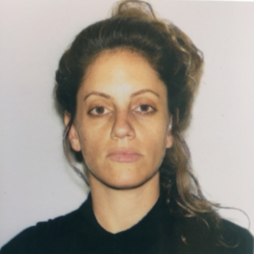
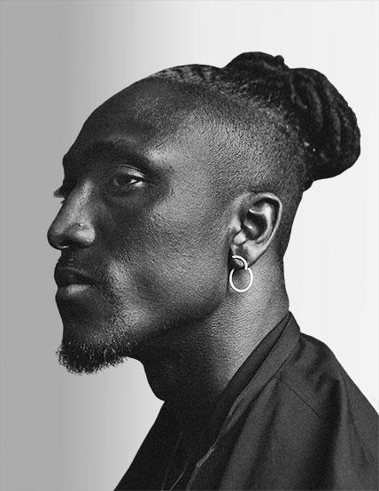
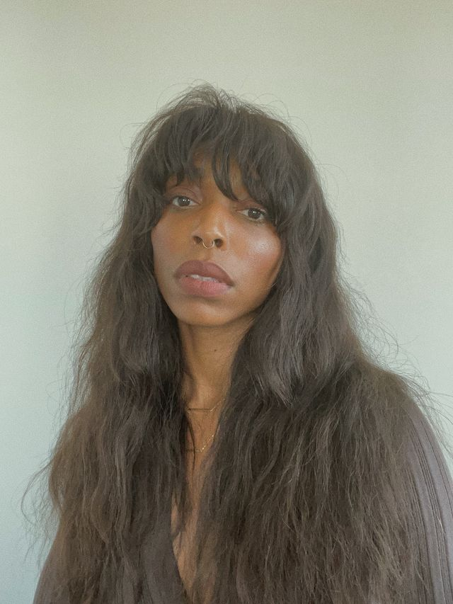
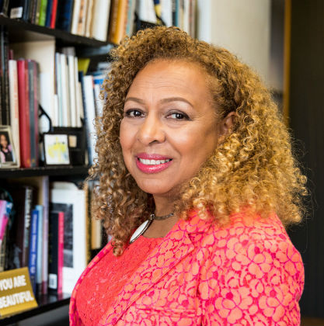
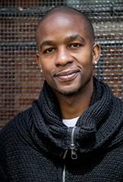
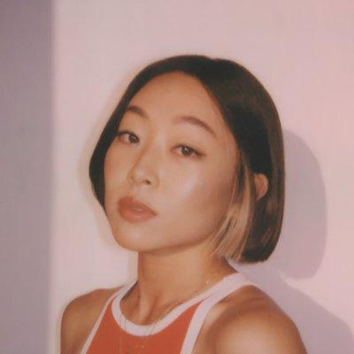
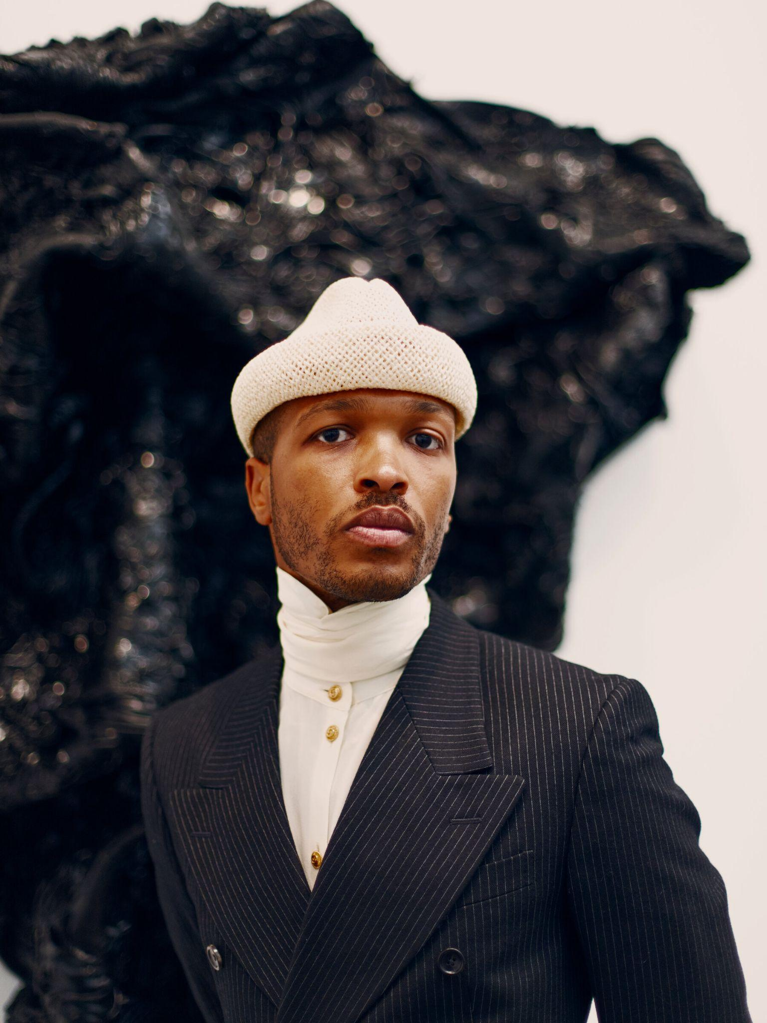
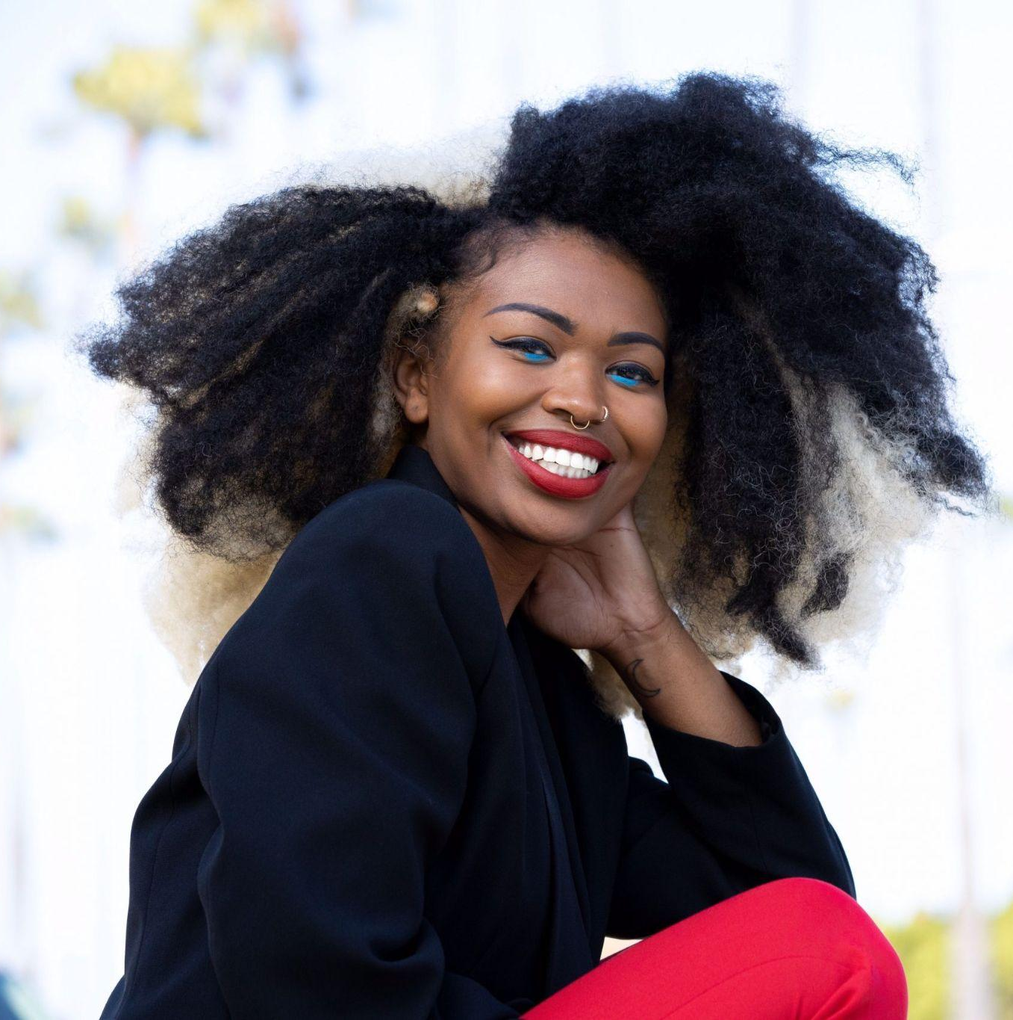
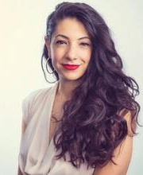
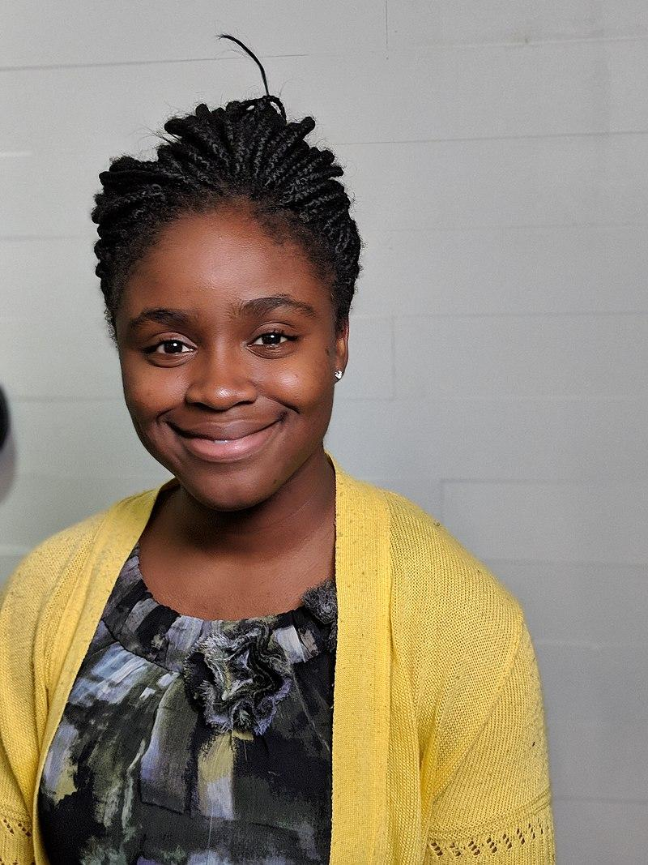
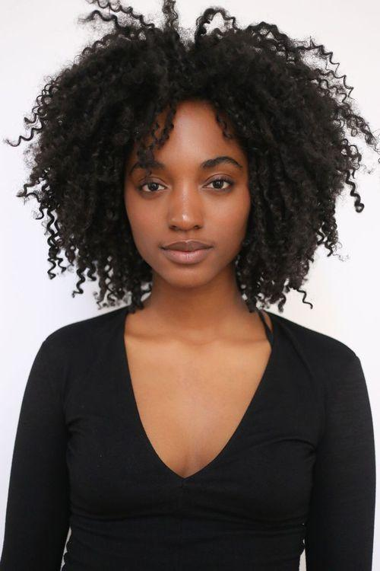
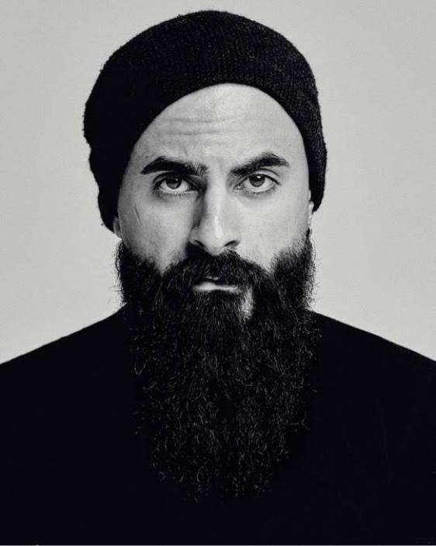
VIP Attendees
VIP guests in both LA & NY will consist of a diverse group* of image experts and professionals including academics, artists, creatives, and technologists whose work reflects and resonates with the goal of Google’s Image Equity Initiative.
Link to Guest List
Shoghig Halajian
[Academics]
Curator & Researcher
UC San Diego
Joshua Kissi
[Artist]
Photographer
*Real Tone Image Expert
Deun Ivory
[Artist]
Photographer
*Real Tone Image Expert
*Note: All guests shown on this slide are examples, and are subject to outreach and confirmation.
Kellie Jones
[Academics]
Art Historian
Columbia University
Wade Davis Jr.
[Misc/Industry]
Head of Product Inclusion, Netflix
June Kim
[Artist]
Photographer Creative Director
Antwaun Sargent
[Media/Comms]
Director and Curator of Gagosian
Autumn Breon
[Technologist]
Curator + Former NASA Engineer
Maytha Alhassen
[Academics]
Producer, Writer, Fellow
Harvard University
Deborah Raji
[Technologist]
Computer Scientist + Activist
Gabby Richardson
[Misc/Industry]
Model + Activist
Shayan Asgharnia
[Artist]
Photographer
*Real Tone Image Expert

Slide 37
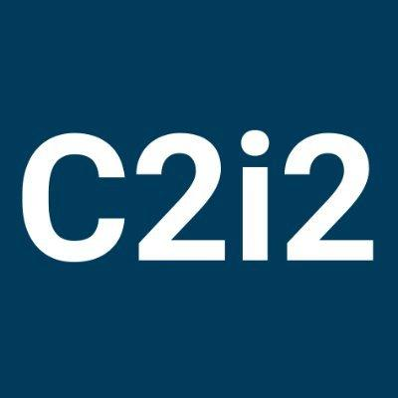


Student + Org Attendees (LA)
Link to Guest List
UCLA - Dean of the Social Sciences, Dr. Darnell Hunt and Co-founder director of the Center for Critical Internet Studies, Dr. Safiya Noble will be sharing with their students accordingly.
Black Image Center - Collective-based non profit founded by a group of young Black Photographers in LA that aims to cultivate imagination through photography and economically empower Black
storytellers and image makers
Las Fotos Project - Mission is to elevate the voices of girls & gender-expansive youth from communities of color through photography and mentoring, empowering them to channel their creativity for the benefit of themselves, their community, and future careers.
UCLA Student Groups
Black Image Center
Las Fotos Project

Slide 38
Products
Google’s Work on Image Equity
Beyond8 | Creative Theory Agency, 2022

Slide 39



Product Highlights
Image Equity at Google
Three digital screens placed throughout the event will describe our specific product efforts behind Real Tone on Google Pixel 6, Real Tone in Google Photos Auto-Enhance and Light Adjustment in Google Meet.
These screens will play on loop without audio, showing examples of improved results, as well as background on our approaches to making these advances (e.g. expert partnerships, dogfooding, etc.).
See briefe here.

Slide 40
Food + Beverage
Light bites from local vendors
Beyond8 | Creative Theory Agency, 2022

Slide 41


Food + Beverage
FLAVORS
FROM AFAR
LOS ANGELES, CA
Service: Passed Apps (4/7)
Flavors From Afar, is a proud Black-owned, largely woman-operated, social enterprise with a mission to employ former refugees and asylum seekers. Most known for our rotating international cuisines - we also provide on-the-job training for our refugee/asylum seeker staff and provide a 5% profit share with our rotating Chef participants. So far, we've partnered with chefs from Afghanistan, Egypt, Guatemala, Haiti, Kenya, Palestine, Somalia, and more!
Flavors’ proceeds offer a form of sustainability for our non-profit partner, The Tiyya Foundation, and help further Tiyya’s mission to provide long-lasting and sustainable assistance to families of refugees, immigrants, and displaced indigenous communities. Tiyya serves approximately 150 families, which includes over 600 individuals, 400 of which are children. Learn more about Tiyya here.
HIGHLIGHTED MENU ITEMS
Somali Chicken Pinwheels
Egyptian Lamb Meatballs
Palestinian Salad Cups
Eritrean Fried Lentil Patties
Guatemalan Mini Ceviche Tostada
Non-Alcoholic Beverage Options:
In-house juices
Jamaican Hibiscus
Tamarindo

Slide 42

Food + Beverage
ADAM’S WINE SHOP
LOS ANGELES, CA
Service: Wine + Beer (4/7)
Adams wine shop is a specialty boutique wine shop focusing on wine produced by women and BIPOC, wherever they may be in the world. The shop was founded with Certified Sommelier Ruben Morancy, who has worked in many aspects of the beverage industry, from restaurants to wineries to retail. Formerly the wine director at Coi in San Francisco, Ruben developed a program of both special occasion wines, as well as delicious wines under $30 per bottle for everyday drinking. Adams Wine Shop is now run by Jaela Salala, who trained under Ruben
HIGHLIGHTED MENU ITEMS
POC-owned White and Red wine varietals
Bottled and canned beer options
(Ex. Crown & Hops, an Inglewood based brewery)

Slide 43

Food + Beverage
HAPPY ICE
LOS ANGELES, CA
Service: Frozen Treats (4/8)
Happy Ice is an ultra-premium Water Ice product, made from a secret recipe from Philadelphia with an artistic LA twist. It has the smooth, rich, creamy texture of an ice cream and the light, fruity flavors of sorbet and refreshing like shaved ice. Happy Ice is all these amazing product in one, without egg or dairy products of any kind.
The resulting combination is an incredibly delicious and vibrant explosion of colors and flavors that brings happiness to any situation. It’s also vegan friendly & contains no nut products, so nearly everyone can enjoy the incredible experience of Happy Ice.
HIGHLIGHTED MENU ITEMS
Cherry Bomb (Top Seller!)
Mango Madness (Top Seller!)
Pineapple Potion (Top Seller!)
Lucky Lemong

Slide 44
Gifting
Beyond8 | Creative Theory Agency, 2022

Slide 45





Value: (3 Editions)
- $20.97 (qt)
- $11.87 (qt)
- $17.47 (qt)
Gifting
VIP guests will receive custom Future Is Color totes filled with thoughtfully curated publications from Aperture, branded items and the Google Pixel 6 with Real Tone™ Technology.
Value: $599 (qt)
Google Pixel 6 + Case
Aperture Magazine Publications:
Vision & Justice
Latin X
The Colors We Share
Custom Erwin Hines Tote Bag
Microfiber “Shirley Card” Cloth
BPA Free Glass Water Bottle
Total Value = $684.98
Value:
$13.67 (qt)
Value:
$2 (qt)
Value: $20 (qt)

Slide 46
Graphics
Beyond8 | Creative Theory Agency, 2022

Slide 47

WIP
Temi Coker Artwork
Inspired by the Shirley Card and color checker tool, we commissioned Temi Coker to develop this artwork to serve as key art for the events.
This art may be applied to:
Save the date(s) and invitation(s)
Onsite print collateral
Inspiration for decor
Set design

Slide 48


event lock up
leveraged throughout

Slide 49

Approved Design Direction

Slide 50

vaccine notice
mounted on venue walls of the 1st floor registration area
SIZE
8.5” X 11”
COPY
You must provide proof of vaccination and I.D. for entry.

Slide 51


restroom signage
vinyl adhered to existing dimensional sign
OPTION A
SIZE
9” X 3”
COPY
All Gender Restroom
OPTION B

Slide 52


monitor holding slides
integrated branding
SIZE
1920 x 1080
A
B
C

Slide 53
Copy
*link to copy deck to be added
Beyond8 | Creative Theory Agency, 2022

Slide 54


Event Copy
Surfaces that will have copy throughout the event
Notes:
Frederick Douglass Excerpts

Slide 55
BA Uniforms
*link to deck to be added
Beyond8 | Creative Theory Agency, 2022

Slide 56

Final: 3/30

Slide 57
BA
Talking Points
*link to deck to be added
Beyond8 | Creative Theory Agency, 2022

Slide 58
Thanks!
Beyond8 | Creative Theory Agency, 2022

Slide 59
Graveyard
Beyond8 | Creative Theory Agency, 2022

Slide 60





NOT UPDATED
Speakers
1. Historical Perspective -
2. Technical
3. Industry
4. Future-Focused
Link to topic description(s)
Florian Koenigsberger , Google
Technical
Award-winning cinematographer working most notably on HBO’s “INSECURE”. Contributed to Pixel’s Real Tone enhancements as an image expert in 2021.
MARCI RODGERS, Costume Designer + Stylist
Industry
Academy Award winning costume designer veteran in theatre and film. Her work is directly impacted by the technology used to capture those with varying skin tones; most recently designing for the movie, Passing.
*Note: All speakers shown here are examples, and are subject to outreach and confirmation.
TULSEE DOSHI, Head of Product, Google AI
Technical
DR. MARCUS HUNTER, Professor, University of California, Los Angeles
Future-Focused
Highly regarded author, humanitarian, and Professor of Sociology and African American Studies. His research focuses the relations between societal standards and the Black/POC communities.
JOYCE DE LEMOS, Patented Cosmetic Chemist, Co-Founder & Head of Product Dieux Skin "
Future-Focused
De Lemos is a clinical cosmetic chemist with multiple patents and a co-founder of the transparent skin-care company Dieux.
Notes:
Names linked to Instagram (website if unavailable)

Slide 61
NOT UPDATED
Speakers
Industry Alternatives
Link to topic description(s)
*missing ab+dm, kira kelley, and joel bervell
Notes:
Names linked to Instagram (website if unavailable)

Slide 62
Props
Beyond8 | Creative Theory Agency, 2022

Slide 63
NOT UPDATED
Furniture and Set Additions
Added pieces to bring authenticity and spirit to the activations.
Notes:
FPO - for activation 2 (not a phone demo, more of a gifting station)
Having self functioning booths in each room or one room so people can take a pic and send to themselves.
**B8 to start the workback based on what we have now. Who and when will we begin going
Phone Demo >> Phone bar? gifting bar

Slide 64
Experts’ Works
Beyond8 | Creative Theory Agency, 2022

Slide 65

Experts’ Works Placement
Thought starters for which activations aligns best with each experts’ content.
Expert Integration
Commissioned and licensed content from selected experts, slotted within the individual speaker conversation screens for each activation.
Notes:
FPO - for activation 2 (not a phone demo, more of a gifting station)
Having self functioning booths in each room or one room so people can take a pic and send to themselves.
**B8 to start the workback based on what we have now. Who and when will we begin going
Phone Demo >> Phone bar? gifting bar

Slide 66
WIP
1
Frederick Douglass + History Of Protest

Slide 67
WIP
2
Representation Boom in 70s

Slide 68
WIP
3
The New Standard

Slide 69


Shoot Location
Hudson Loft, Los Angeles, CA
March, 2022

Slide 70


event lock up
leveraged throughout
LOCK UP
ALTERNATE

Slide 71


WIP
Attendee to take picture in the booth, phone stand to take his place
4
The Infinite Palette
The infinite palette explores a concept in which technology is trained to pull color from the subject rather than infuse colors to display a hue.
*find more information on the infinite palette here
Notes:
Call to Action

